Slide 1
SELF–CARE STRAGEGIES
ABROAD
University Health Services // Duck Nest Wellness Center // GEO Study Abroad
Notes:
All

Slide 2
CONGRATULATIONS
ON YOUR UPCOMING PROGRAM!
What are you feeling about your upcoming study abroad experience?
Notes:
Rachana

Slide 3
WHAT MAKES YOU EXCITED?
What activities are you most looking forward to?
What are you excited about learning?
Notes:
Rachana

Slide 4
COMMON
STRESSORS
Everything is different!
Jet lag
Health concerns
Unfamiliar culture
Language
Lack of familiar people
Food
Notes:
Rachana

Slide 5
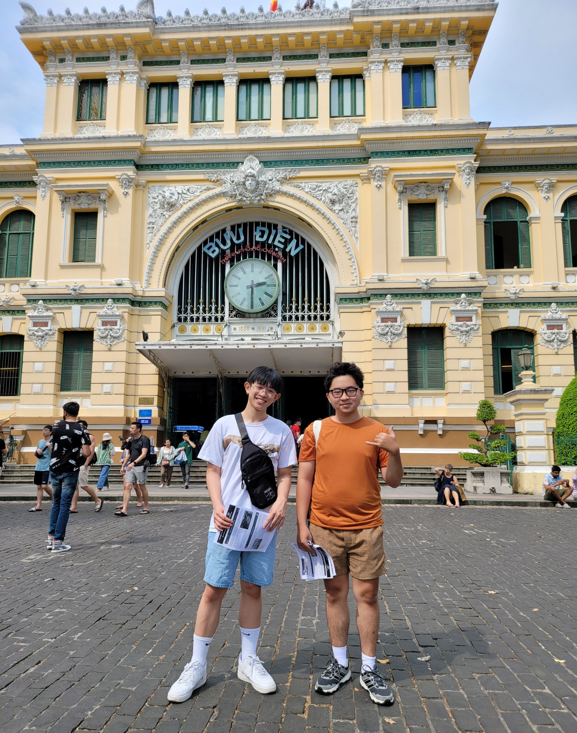
PROBLEM SOLVING ABROAD
EXPECTATION VS. REALITY
Notes:
Alyssa / Ryan

Slide 6
Culture Shift
PREVENTATIVE
Learn about what to expect
Learn how to say key phrases
Different living conditions
Excessive heat/humidity
Different social norms
Strangeness fatigue
Workplace norms
SKILLS
Perspective taking
Re-frame the situation
Notes:
Alyssa

Slide 7
HOUSING CONFLICTS
HOST FAMILY AND/OR HOUSEMATES
House rules
Letting them know where you are
Sharing food
SKILLS
PREVENTATIVE
Be open to hearing alternatives
Remember your purpose
Everything in temporary
Talk about expectations
Notes:
Alyssa

Slide 8
GETTING LOST
The downside of travel to new places
City streets can be old and winding
Cell phone signal can be intermittent
Cell phone batteries die
PREVENTATIVE
SKILLS
Notice landmarks
Bring a backup charger
Keep a cool head!
Ask for directions
Notes:
Alyssa

Slide 9
LONELINESS
Feeling isolated because of identity
Challenges connecting with others
Being away from your built support system
PREVENTATIVE
Find ways to get involved
Ask your host family for ideas
Get to know your community
SKILLS
Advocate for yourself!
Tolerate short-term discomfort
Notes:
Ryan

Slide 10
HOW DO WE REDUCE STRESS?
DIFFERENT TYPES OF COPING STRAGEGIES
Notes:
Rachana

Slide 11
STRESS
How do you know when you are too stressed?
What are signs and symptoms you experience?
Notes:
Rachana
Anyone have anything they can share?
When I get stressed, I mentioned I get the rash, and also, my eyelid twitches. Its not cool.

Slide 12
WHAT IS STRESS?
Notes:
Rachana
Here how we look at stress from a good stress/bad stress perspective.
Stress can motivate us to plan what we will bring with us, to research what we might need to know or want to know about the place we are going.
We’ve all experienced the stress of an approaching deadline helping us focus.
Getting into the yellow zone is like when you start your paper at 11pm the night before its due.
The red zone might be when you are frantically start your 7 page essay the hour before its due.
Stress while travelling works the same.

Slide 13
MINDSET SHIFT
Conversation
Explore your neighborhood alone or with a peer
Go on a walk
Read
Try a new café or local shop
Call home
Take photos

Slide 14
GROUNDING
Breathing exercises
Yoga
Meditation
Exercise
5 senses mindfulness
Fidgets

Slide 15
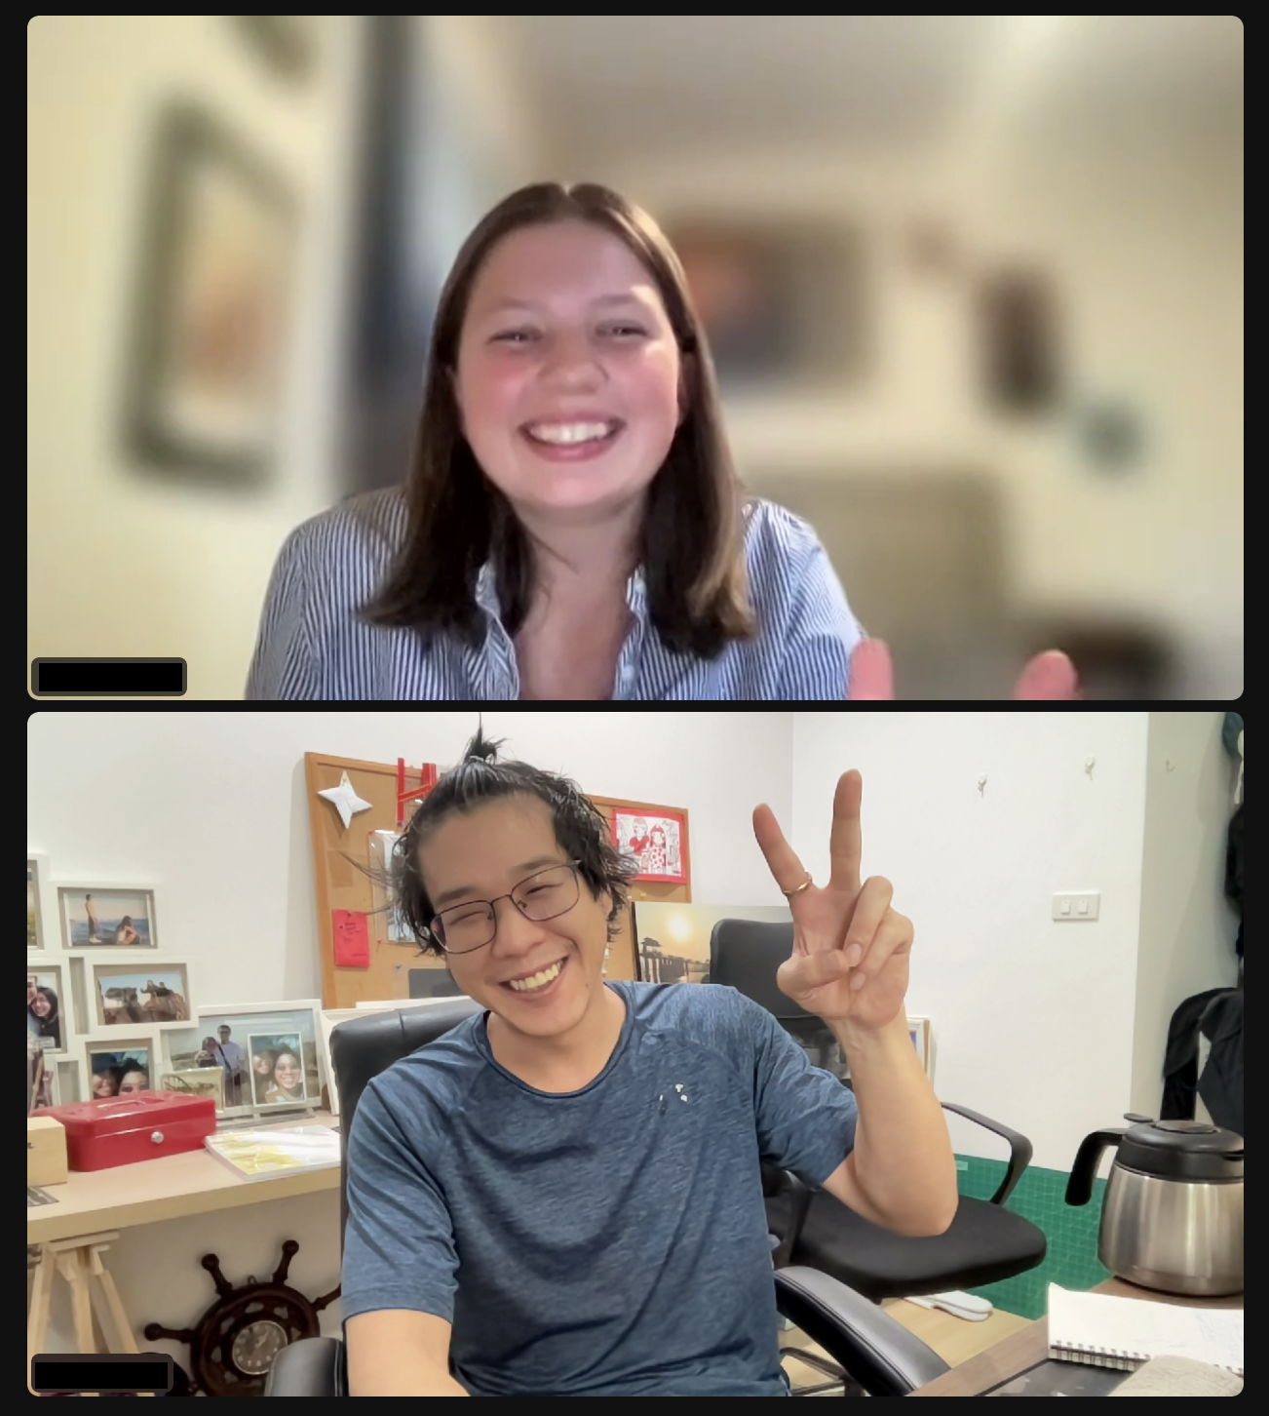
EMOTIONAL RELEASE
Dance party
Cry
Laugh
Punch a pillow
Talk to a friend
Make art
Journal

Slide 16
COMMUNITY CARE
Fellow GEO/ GlobalWorks students
A local shop that caters to your interest (ex: craft store)
What identities are important to you
Volunteering

Slide 17
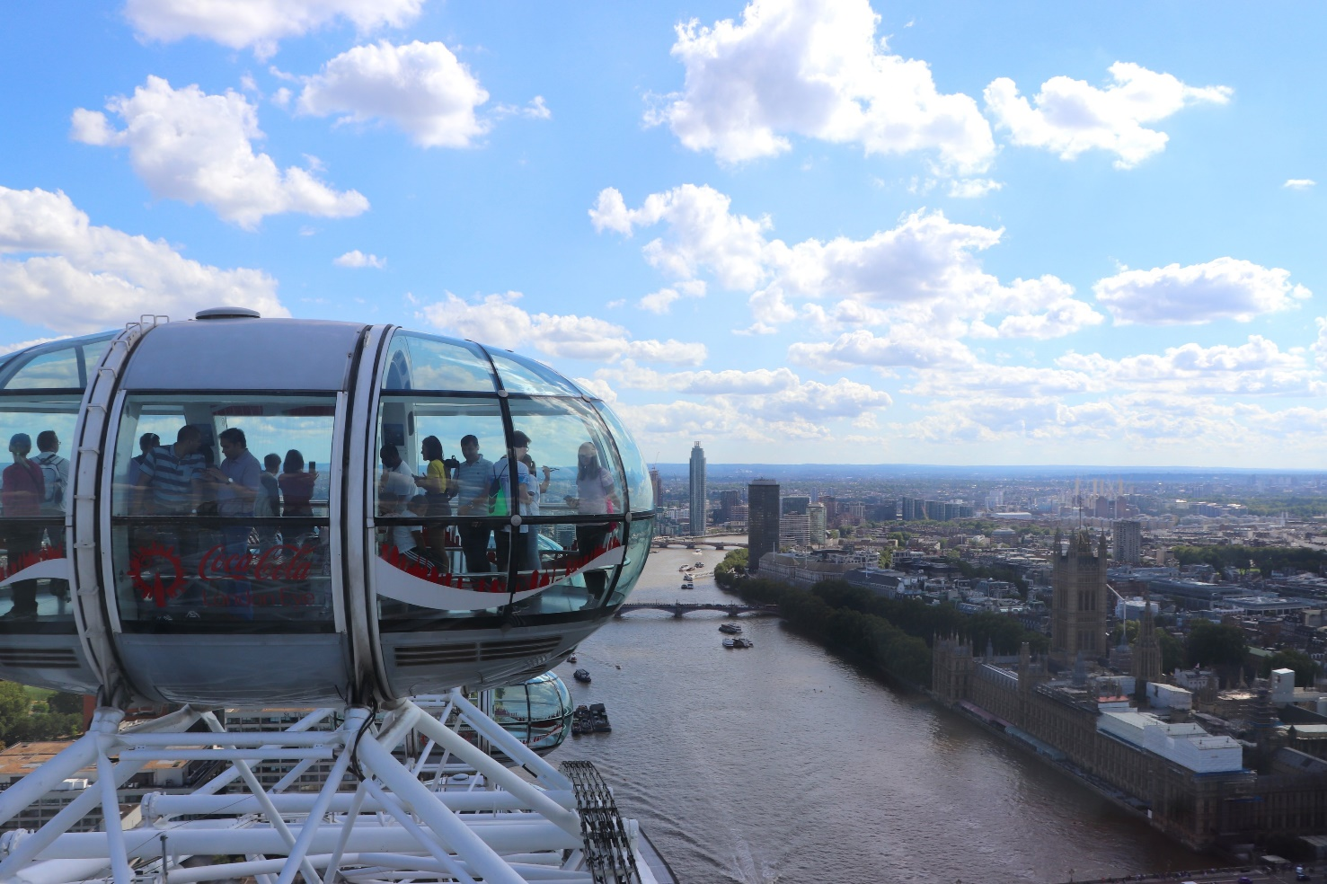
SELF-CARE RESOURCE APPS
WellTrack
TELUS Health Student Support
Finch
Headspace
Pause
White Noise Apps
Meditations on YouTube or Spotify

Slide 18
COMFORT PLAN
GET A PIECE OF PAPER, YOUR COMPUTER, OR START A NOTE ON YOUR PHONE

Slide 19
QUESTIONS TO ASK YOURSELF
What helps me alleviate anxiety
What helps me alleviate sadness?
What clothes give me comfort?
What color makes me feel calm, powerful, or confident?
Who can I talk to for a venting session?
Who can I talk to for distraction
What media brings me comfort
What do I need to bring from home to ensure my physical and mental health are taken care of?

Slide 20
MENTAL HEALTH RESOURCES
UO SAFE HOTLINE
541-346-SAFE (7233)
COUNSELING SERVICES AFTER HOURS
541-346-3227
CRISIS TEXT LINE
TEXT HOME TO 741-71
CAN USE ON WHATSAPP
TELLUS STUDENT SUPPORT APP
24/7 SUPPORT
WEEKLY THERAPY SESSIONS
PODCASTS
WELLNESS ARTICLES

Slide 21
THANK YOU!

