Slide 1
How to Make Your Money Last
Unpacking Budgeting Abroad
Notes:
Introductions

Slide 2
Session Overview
Discuss how budgets are organized
How to avoid going over budget
Maximizing budget
Questions to ask yourself
Notes:
Sarah

Slide 3
How Budgets are Organized
Program fees
$500 deposit/ UO Study Abroad Fee
Program fee for your specific program
Estimated expenses
Airfare, transportation, meals, cell phone, passport, additional living expenses, etc.
Notes:
Quinne

Slide 4
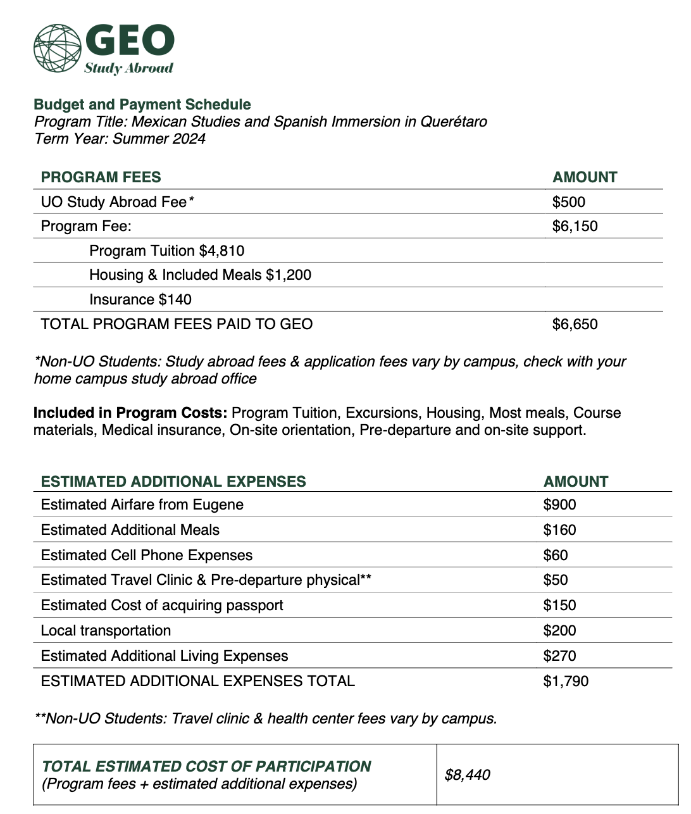
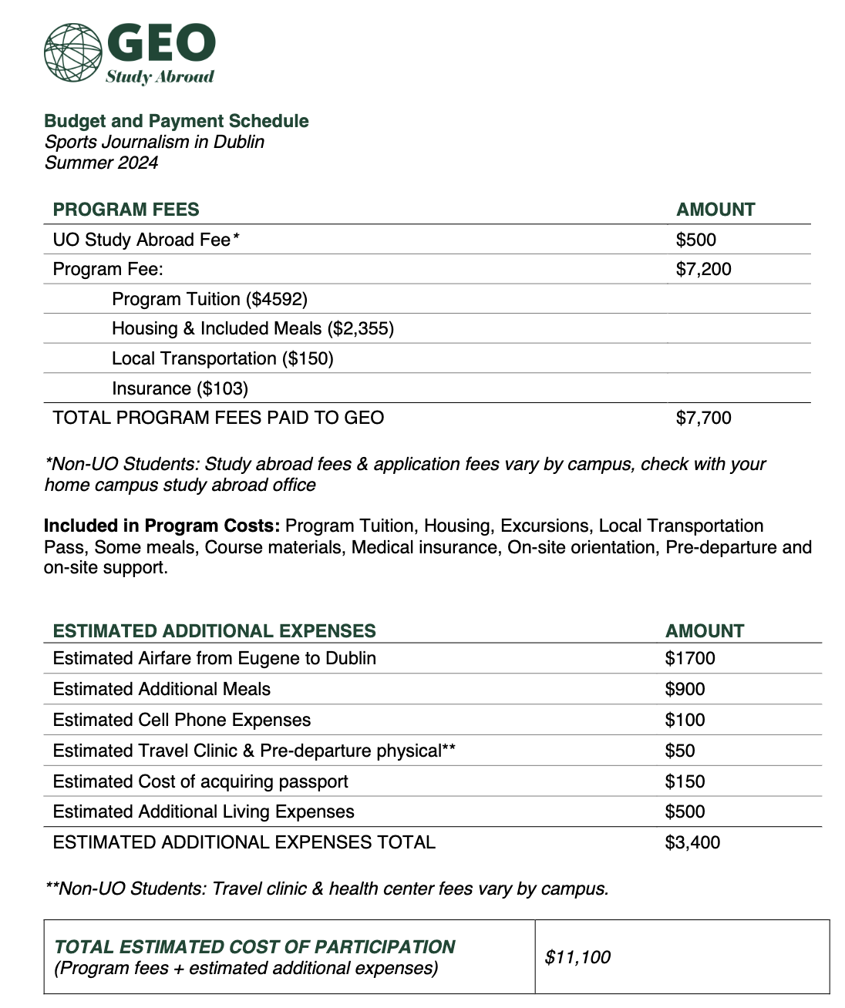

Slide 5
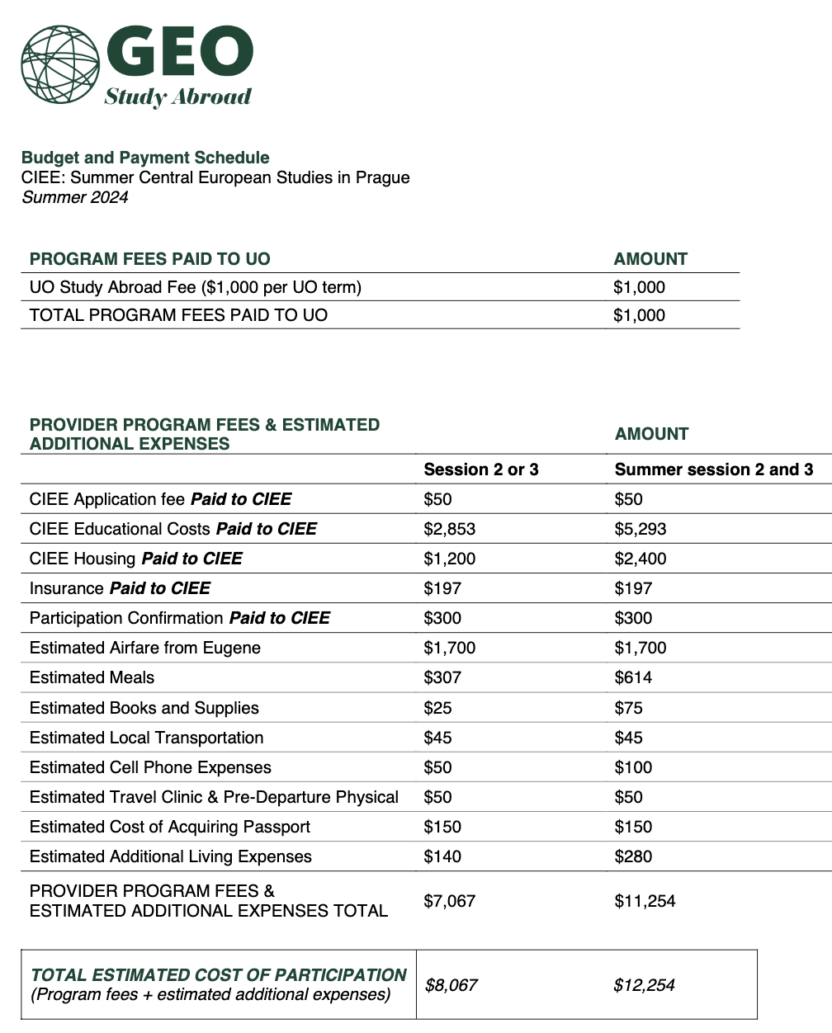
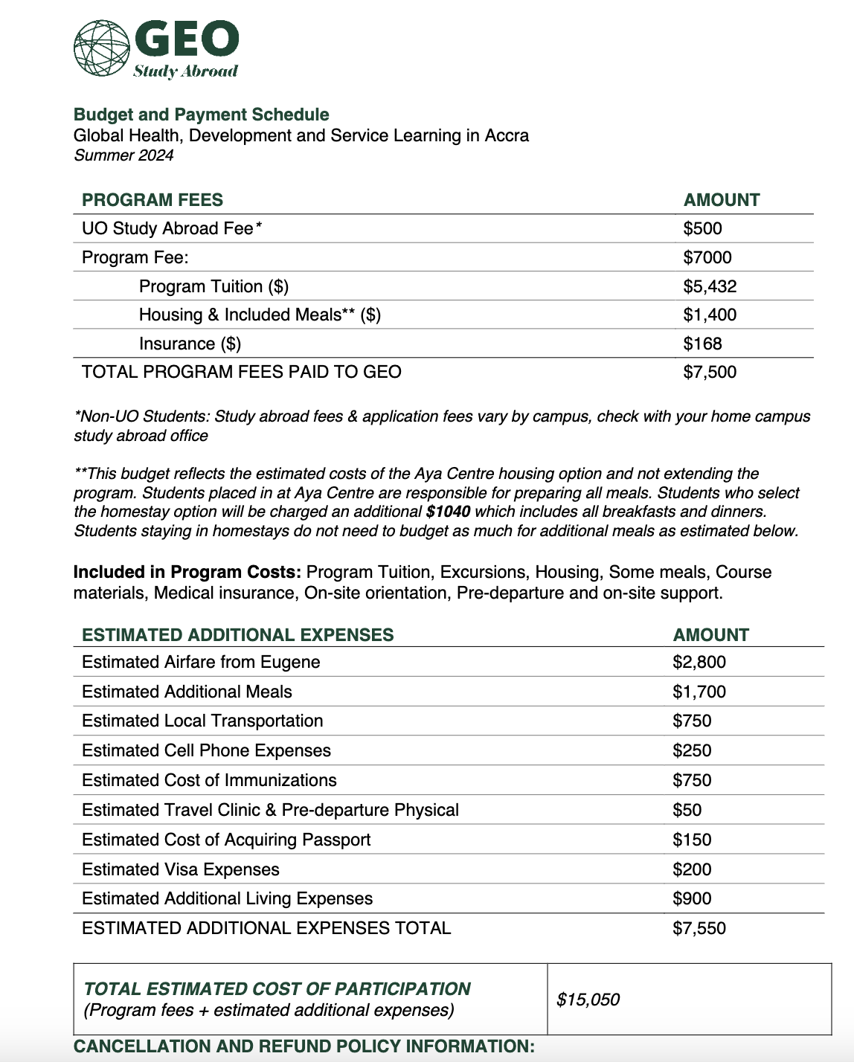

Slide 6
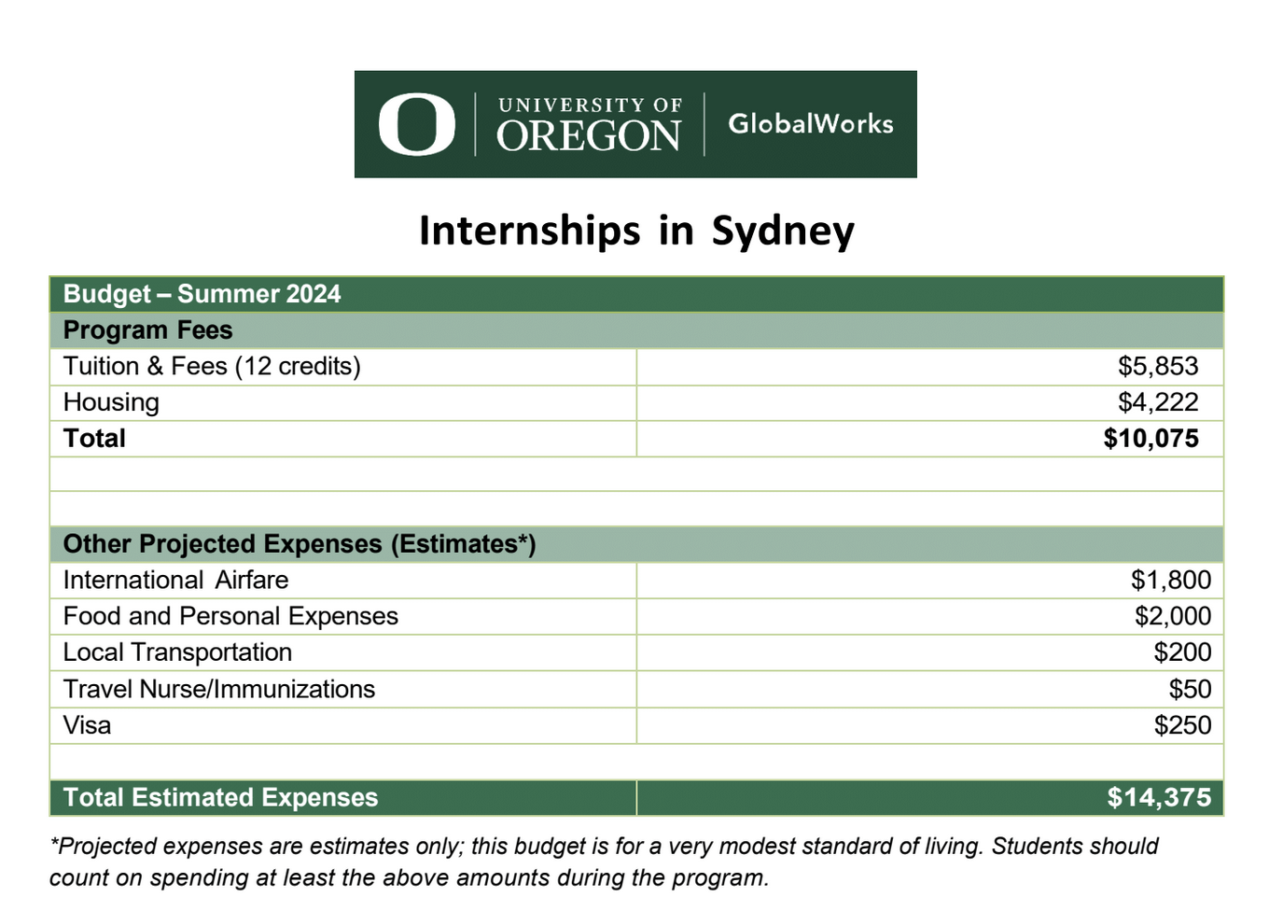
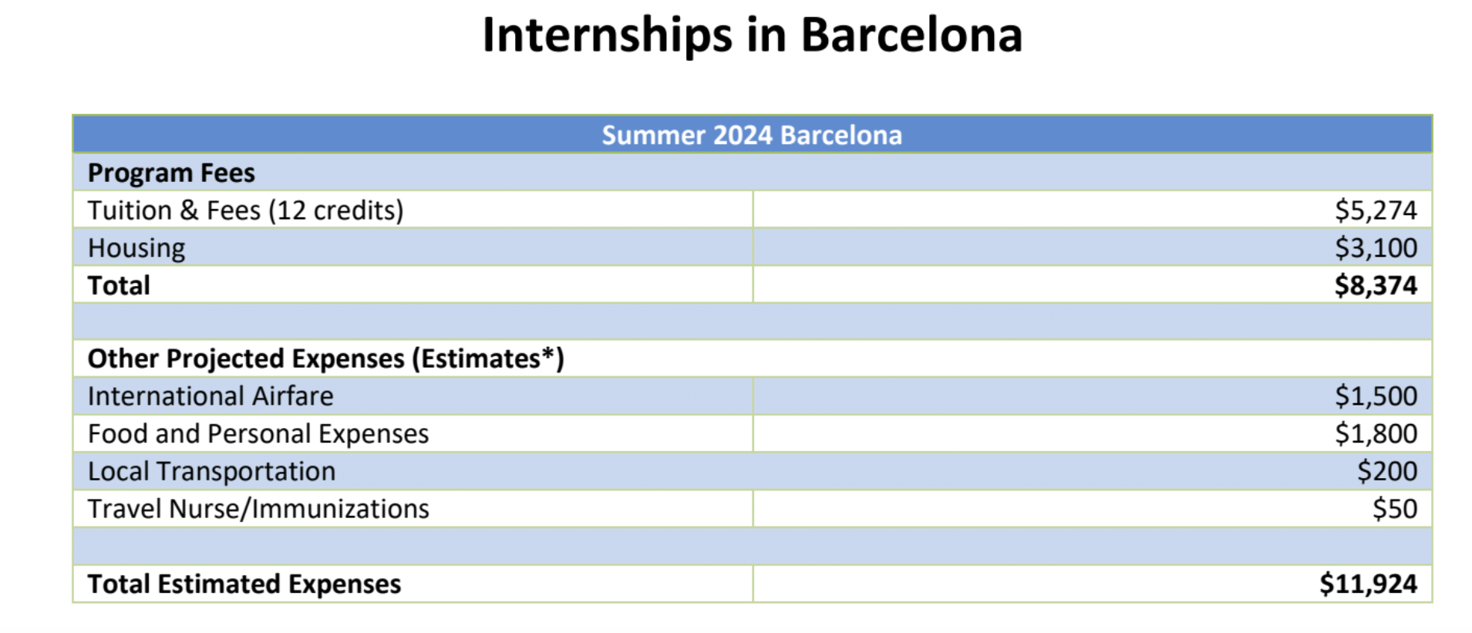
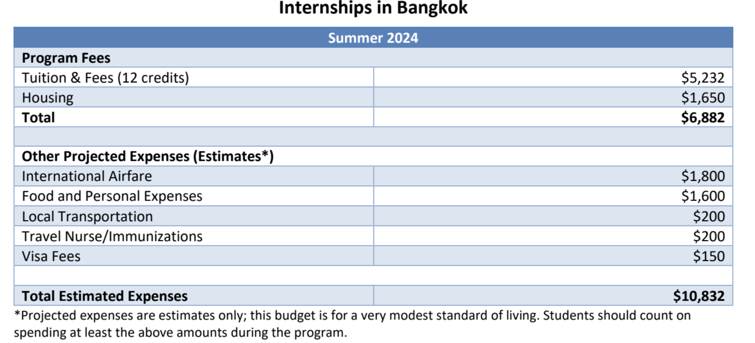

Slide 7
How to Avoid Going Over Budget
Take local buses or trains
Ubering everywhere is more expensive and often unnecessary
Limit nights out
Drinks and dinners out can add up quickly
Take advantage of included meals on your program
Understand the exchange rate of the currency abroad
Notes:
Sarah

Slide 8
How to Avoid Going Over Budget
5. Plan for estimated expenses listed on the program budget
Some items might be budgeted but not explicitly stated in budget: laundry, transportation from airport, food on excursions
6. Review and understand your program budget and program offerings.
Create weekly budgets to stay on track financially
7. Have your own budget for personal travel
Notes:
Sarah

Slide 9
Personal Travel Budgeting
If you want to go to another country or city while abroad that is outside of the program, consider:
Transport to and from airport, bus or train station
Meal at an airport, bus or train station
Transportation costs to locations and in said locations
Housing
Food
Souvenirs
Notes:
Sarah

Slide 10
Budget: $1200 Days: 28 $1200/28=$42.86
$42.86/1.27= £33.75 per day
£1 = $1.27 Eugene Safeway vs London Tesco Shin Ramen $1.29 vs £1 Apple $1.25 vs. £0.65 Activia $4.49 vs. £2.50 Going Out Eugene vs. London Iced Latte (Grande) $4.25 vs £3.65 Beer (Lager) $6.25 vs. £5.50 Domino Pizza (S) $14.99 vs. £16.99
1x1.27 = 1.27 ($0.02 less!) 0.65x1.27=0.83 ($0.42 less!) 2.5x1.27= 3.18 ($1.31 less!)
3.65x1.27=4.64 (0.39 more!) 5.50x1.27 = 6.99 ($0.74 more!) 16.99x1.27=21.58 ($6.59 more!)
Total: $33.85 x 28= $949 Budget: $1,200 ($251 left)

Slide 11
Budget: $1200 Days: 28 $1200/28=$42.86
$42.86/1.1= €39 per day
€1 = $1.1 Eugene Safeway vs Lyon Carrefour Penne $1.29 vs €0,99 Apple (1 lb) $1.99 vs. €1,50 Greek Yogurt (4) $4.99 vs. €1,39 Going Out Eugene vs. Lyon Iced Latte (Grande) $4.25 vs €4.25 Beer (Lager) $6.25 vs. €5 Pizza (Pepperoni) $10.99 vs €13,90

Slide 12
Maximizing Budget
Explore and experience free events in your study abroad destination(s)
Ask locals for restaurant recommendations
Ask for student discounts
Notes:
Sarah

Slide 13
Questions to Ask Yourself
Does my bank have foreign transaction fees?
What is the cost for purchases/ ATM withdrawals?
Is cash better to use?
What is my weekly/daily budget?
Food, transportation, and additional living expenses
Do I have dietary restrictions?
Will that increase the cost?
What is the kitchen/food situation?
If I have a kitchen, what does it have?
Notes:
Sarah

Slide 14
Questions to Ask Yourself
Do I have my budgeted funds already? /How will you get your budgeted funds prior to departure?
Remember to submit Financial Aid Adjustment Form by June 1
What can I do before your departure to ensure you will be financially stable while abroad?
Research destination, create weekly budget, save money
Notes:
Sarah

Slide 15
Questions?
Notes:
Sarah

