Slide 1
How to Make Your Money Last
Unpacking Budgeting Abroad
Notes:
Introductions

Slide 2
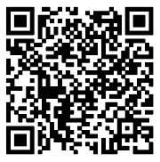
INTRODUCTIONS
Name
Pronouns
Year
Major/Minor
Your study abroad plans
What are you hoping to learn today?
Notes:
Introductions

Slide 3
Agenda Items
Program Costs and GEO Budgets
Trivia! Win a prize!
Why Budgeting is Important
Budgeting Tips
Trivia! Win a prize!
Scholarships and Other Financial Resources
Q&A! Win a prize!
Notes:
Myrna

Slide 4
How to look at Program Costs
Where are program costs?
Budgets are uploaded to every program page
New programs may take longer to get a budget
If the page has an old budget, it is unlikely to increase too much
How are program costs paid
Program fees are paid to GEO
These are static, and may include tuition, insurance, housing, and excursions depending on the type of program
Estimated costs are out of pocket
These are flexible to every student, and are just guesses
Notes:
Quinne

Slide 5
How GEO Budgets are Organized
Program fees
$500 deposit/ UO Study Abroad Fee
Program fee for your specific program
Estimated expenses
Airfare, transportation, meals, cell phone, passport, additional living expenses, etc.
Now for the math!
Notes:
Quinne

Slide 6
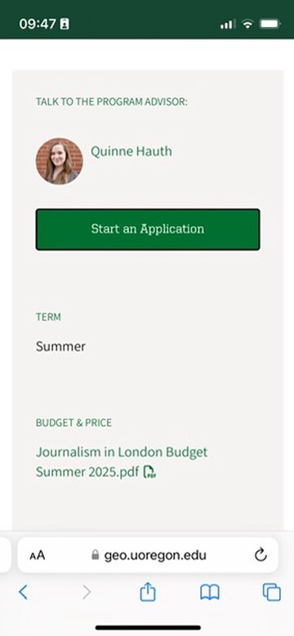
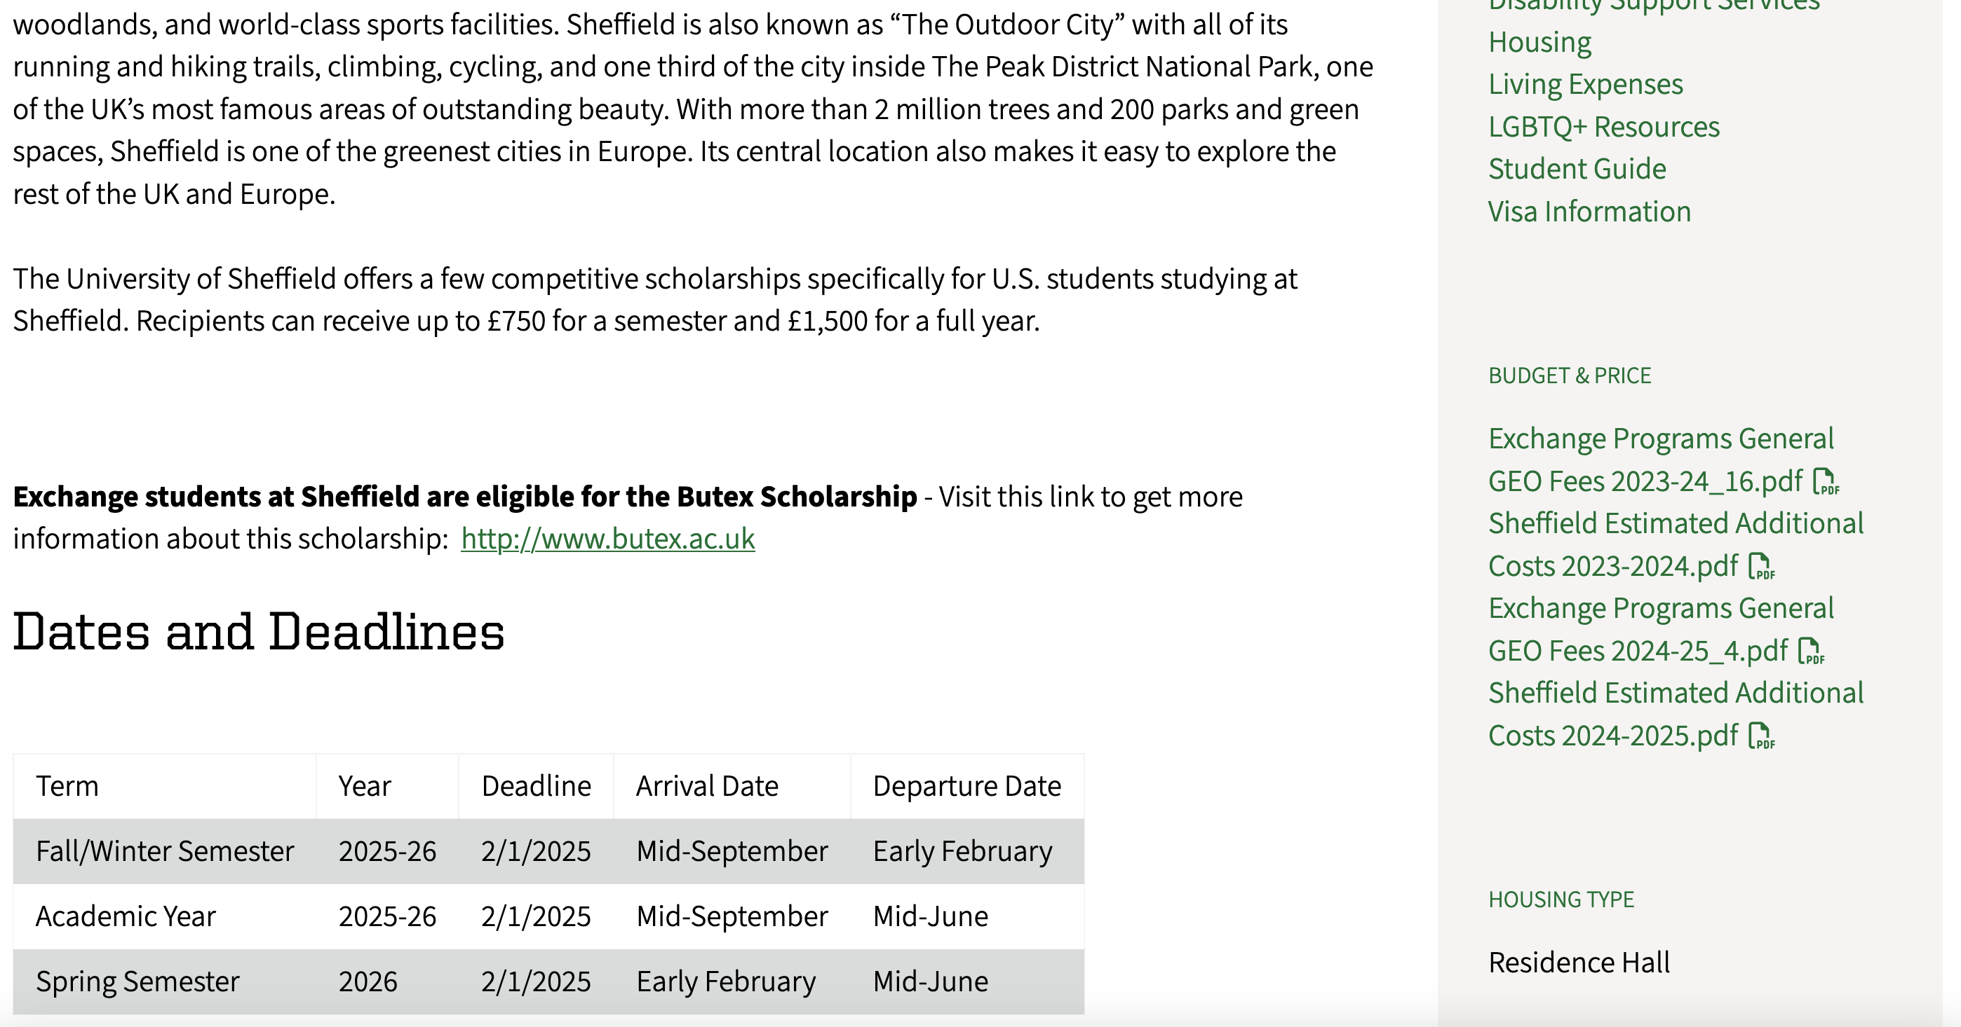
Right hand side
Bottom
Notes:
Quinne

Slide 7
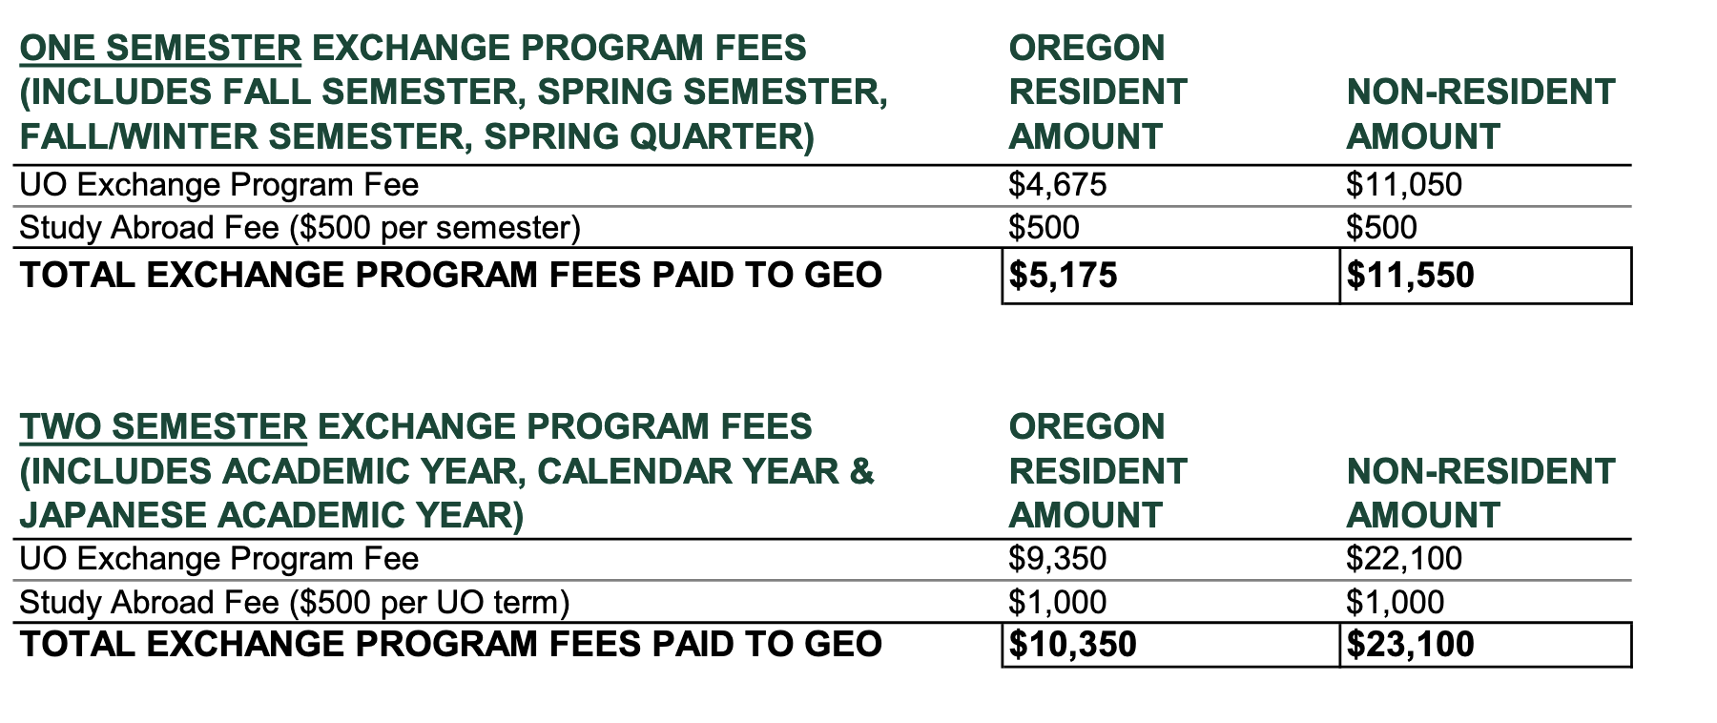
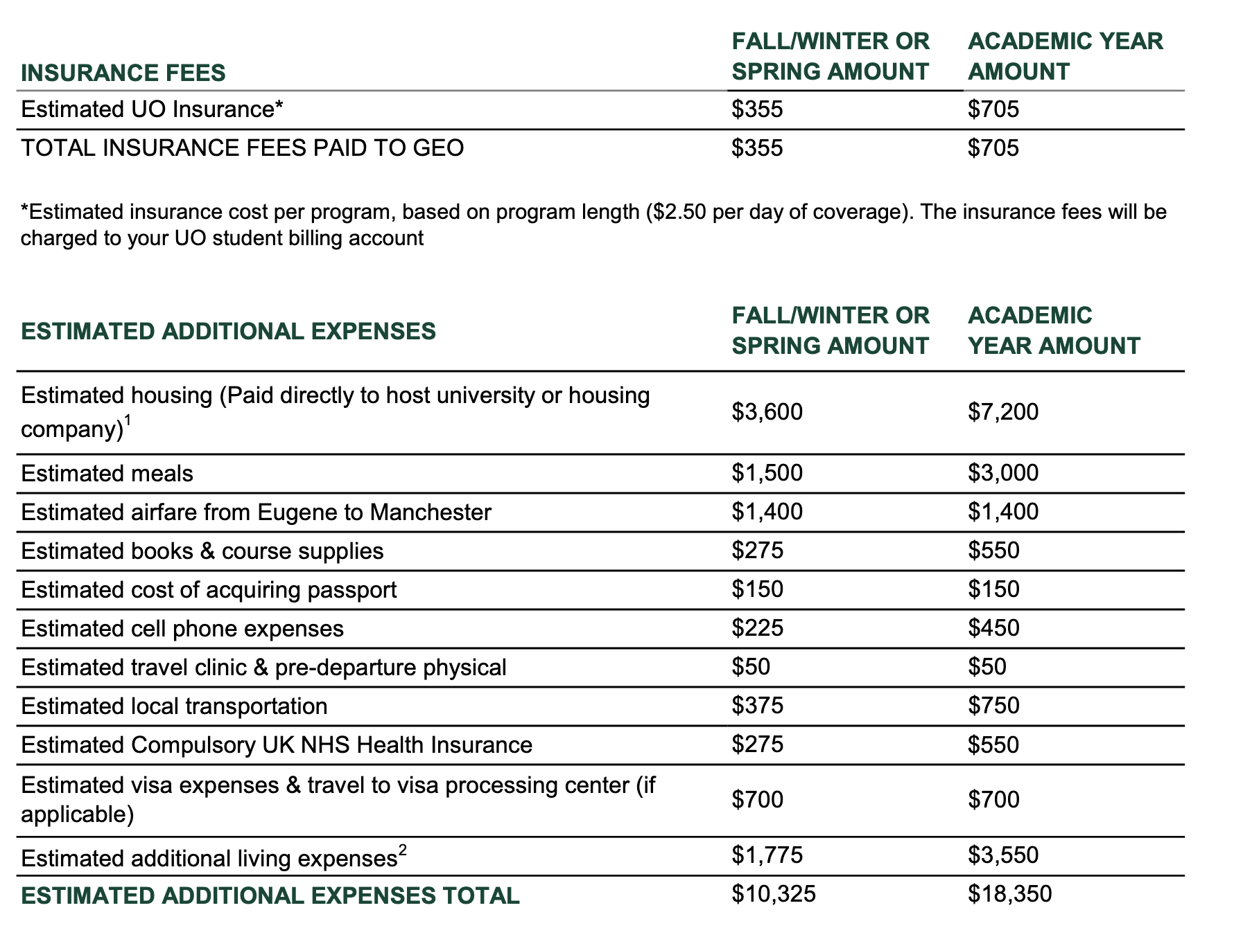
Look at what budgets exist— How are they divided?
GEO programs likely only have one budget per program
Exchange, Direct Enroll, and other programs like CIEE or IE3 may have multiple budgets
This budget has two documents
Exchange General Fees
Divided by residency status and time abroad
Estimated additional costs
Divided by time abroad
Notes:
Quinne

Slide 8
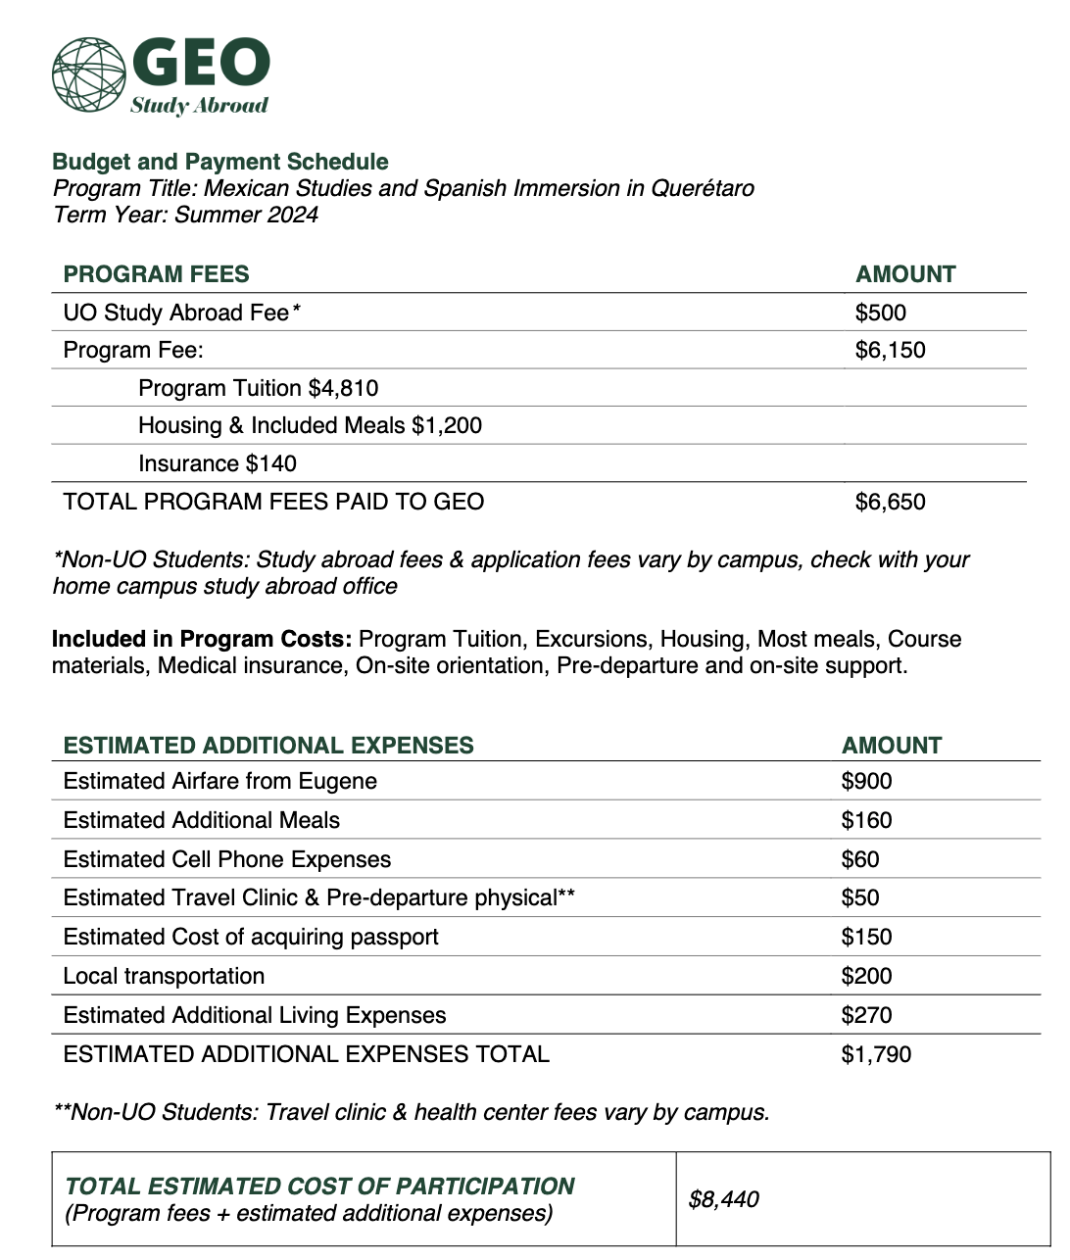
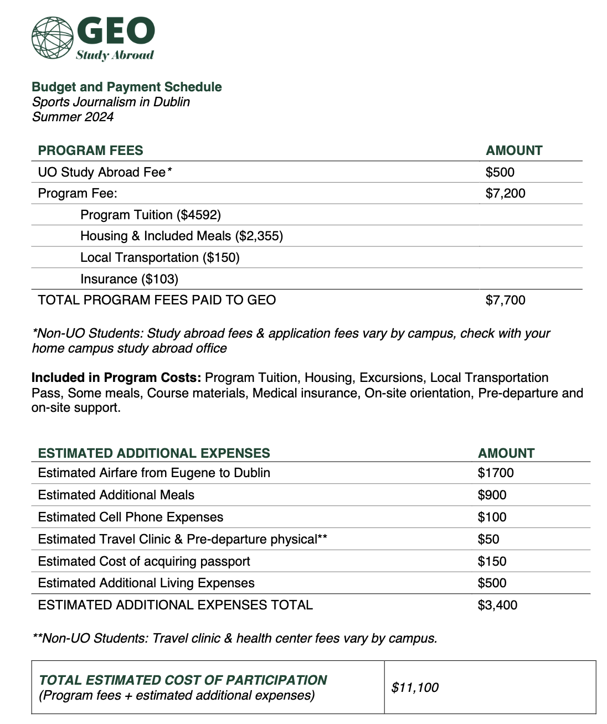
Notes:
Quinne

Slide 9
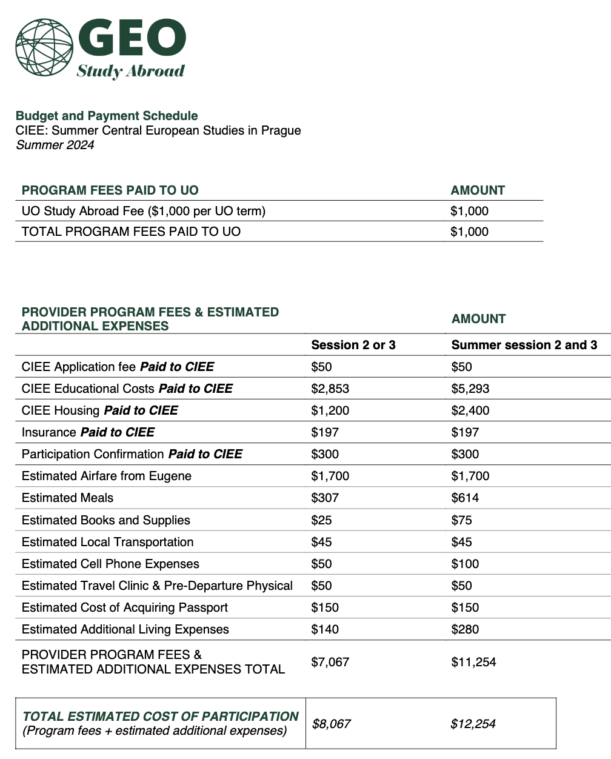
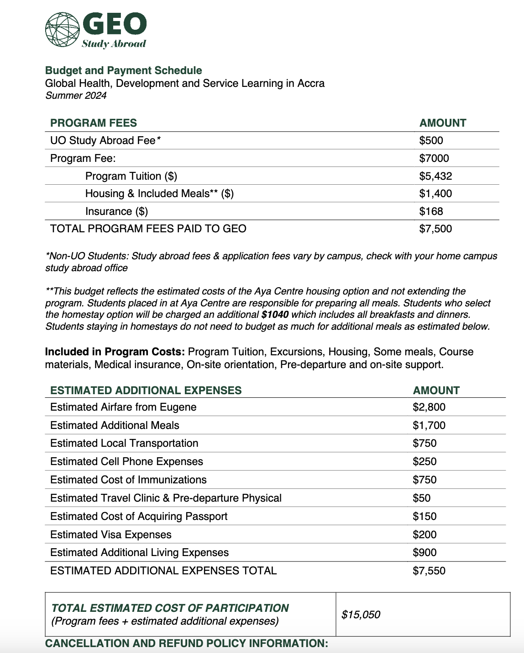
Notes:
Quinne

Slide 10
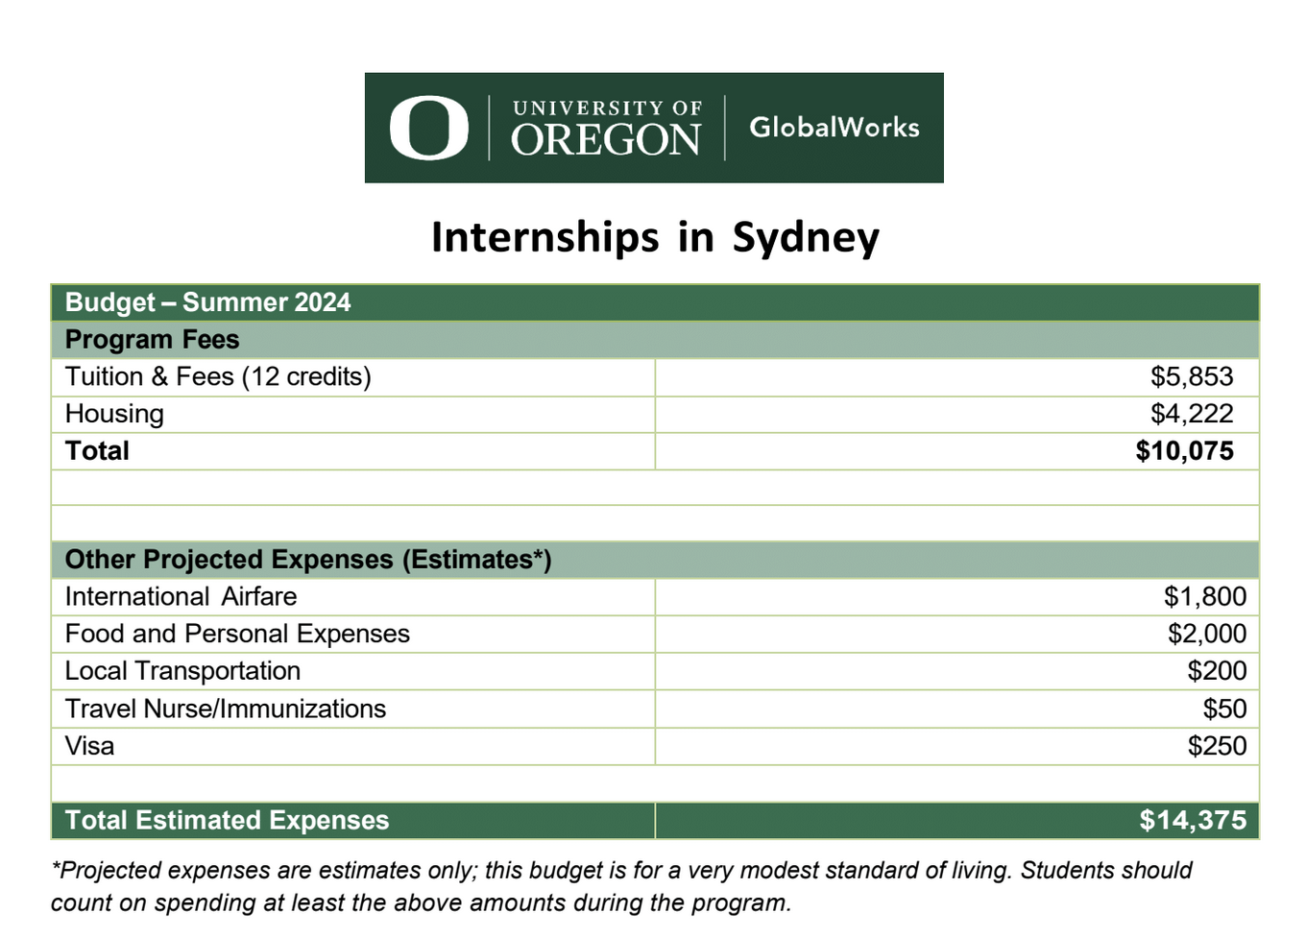
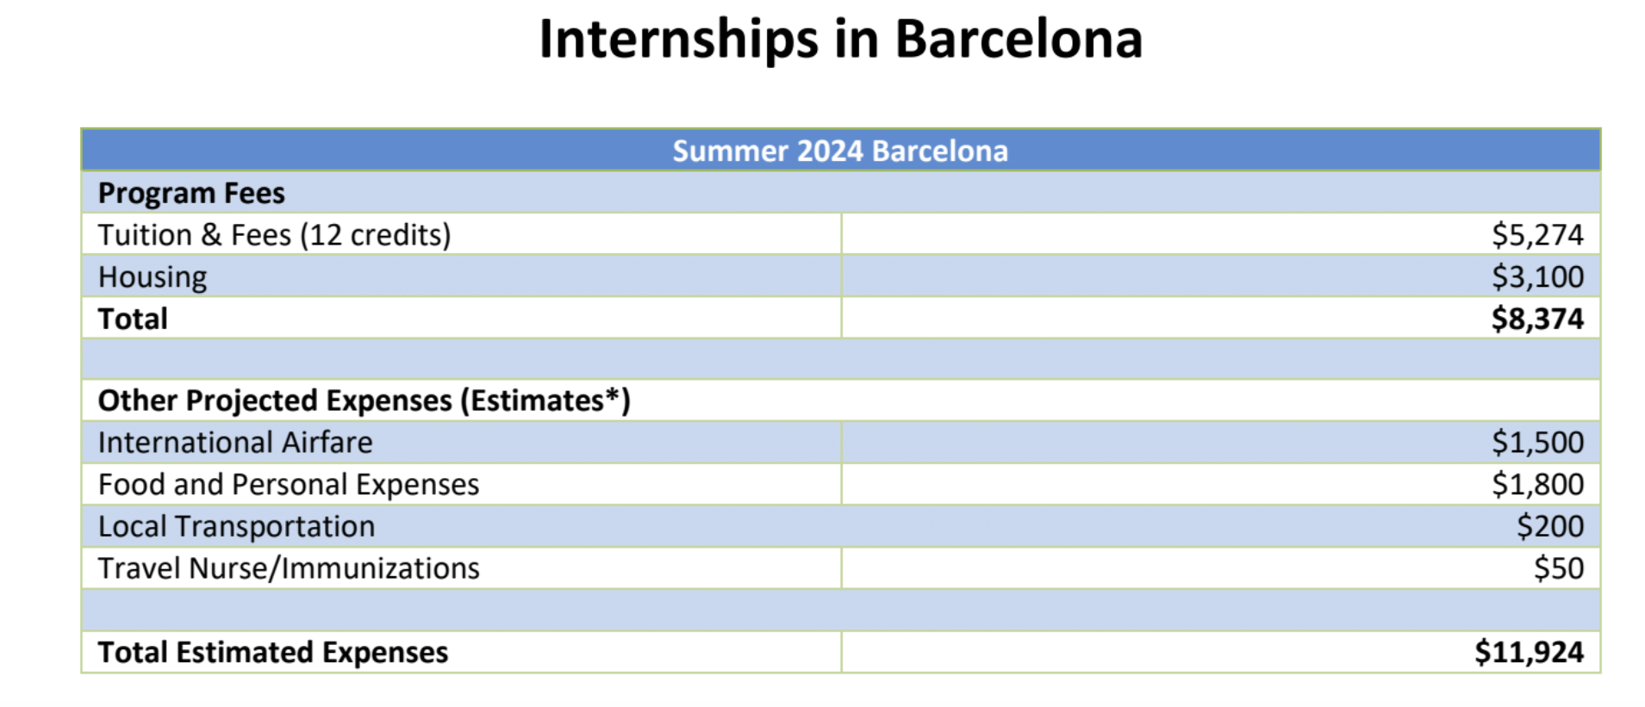
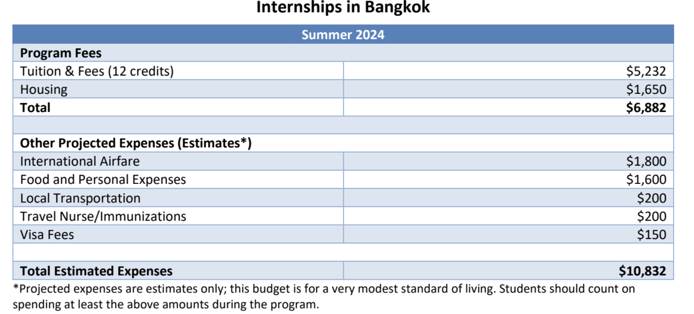
Notes:
Quinne

Slide 11
TRIVIA QUESTION
What is included in program costs?

Slide 12
Budget: $1200 Days: 28 $1200/28=$42.86
$42.86/1.27= £33.75 per day
£1 = $1.27 Eugene Safeway vs London Tesco Shin Ramen $1.29 vs £1 Apple $1.25 vs. £0.65 Activia $4.49 vs. £2.50 Going Out Eugene vs. London Iced Latte (Grande) $4.25 vs £3.65 Beer (Lager) $6.25 vs. £5.50 Domino Pizza (S) $14.99 vs. £16.99
1x1.27 = 1.27 ($0.02 less!) 0.65x1.27=0.83 ($0.42 less!) 2.5x1.27= 3.18 ($1.31 less!)
3.65x1.27=4.64 (0.39 more!) 5.50x1.27 = 6.99 ($0.74 more!) 16.99x1.27=21.58 ($6.59 more!)
Total: $33.85 x 28= $949 Budget: $1,200 ($251 left)
Notes:
Quinne

Slide 13
Budget: $1200 Days: 28 $1200/28=$42.86
$42.86/1.1= €39 per day
€1 = $1.1 Eugene Safeway vs Lyon Carrefour Penne $1.29 vs €0,99 Apple (1 lb) $1.99 vs. €1,50 Greek Yogurt (4) $4.99 vs. €1,39 Going Out Eugene vs. Lyon Iced Latte (Grande) $4.25 vs €4.25 Beer (Lager) $6.25 vs. €5 Pizza (Pepperoni) $10.99 vs €13,90
Notes:
Quinne

Slide 14
When is Tuition Due? How Do I Pay?
Tuition is due in accordance to the UO Billing Cycle
Summer: July 1 Fall: October 1
Winter: January 1 Spring: April 1
Note: If you are abroad for a semester, you will still be billed on this cycle. It will be split up.
How much is due?
The entire tuition will be billed at once if you are abroad for a term or less.
Only deposits are billed separately (ex. $500 program deposit, $250 housing)
All billing is through UO Billing NOT GEO
What about the cancellation timeline?
Notes:
Myrna

Slide 15
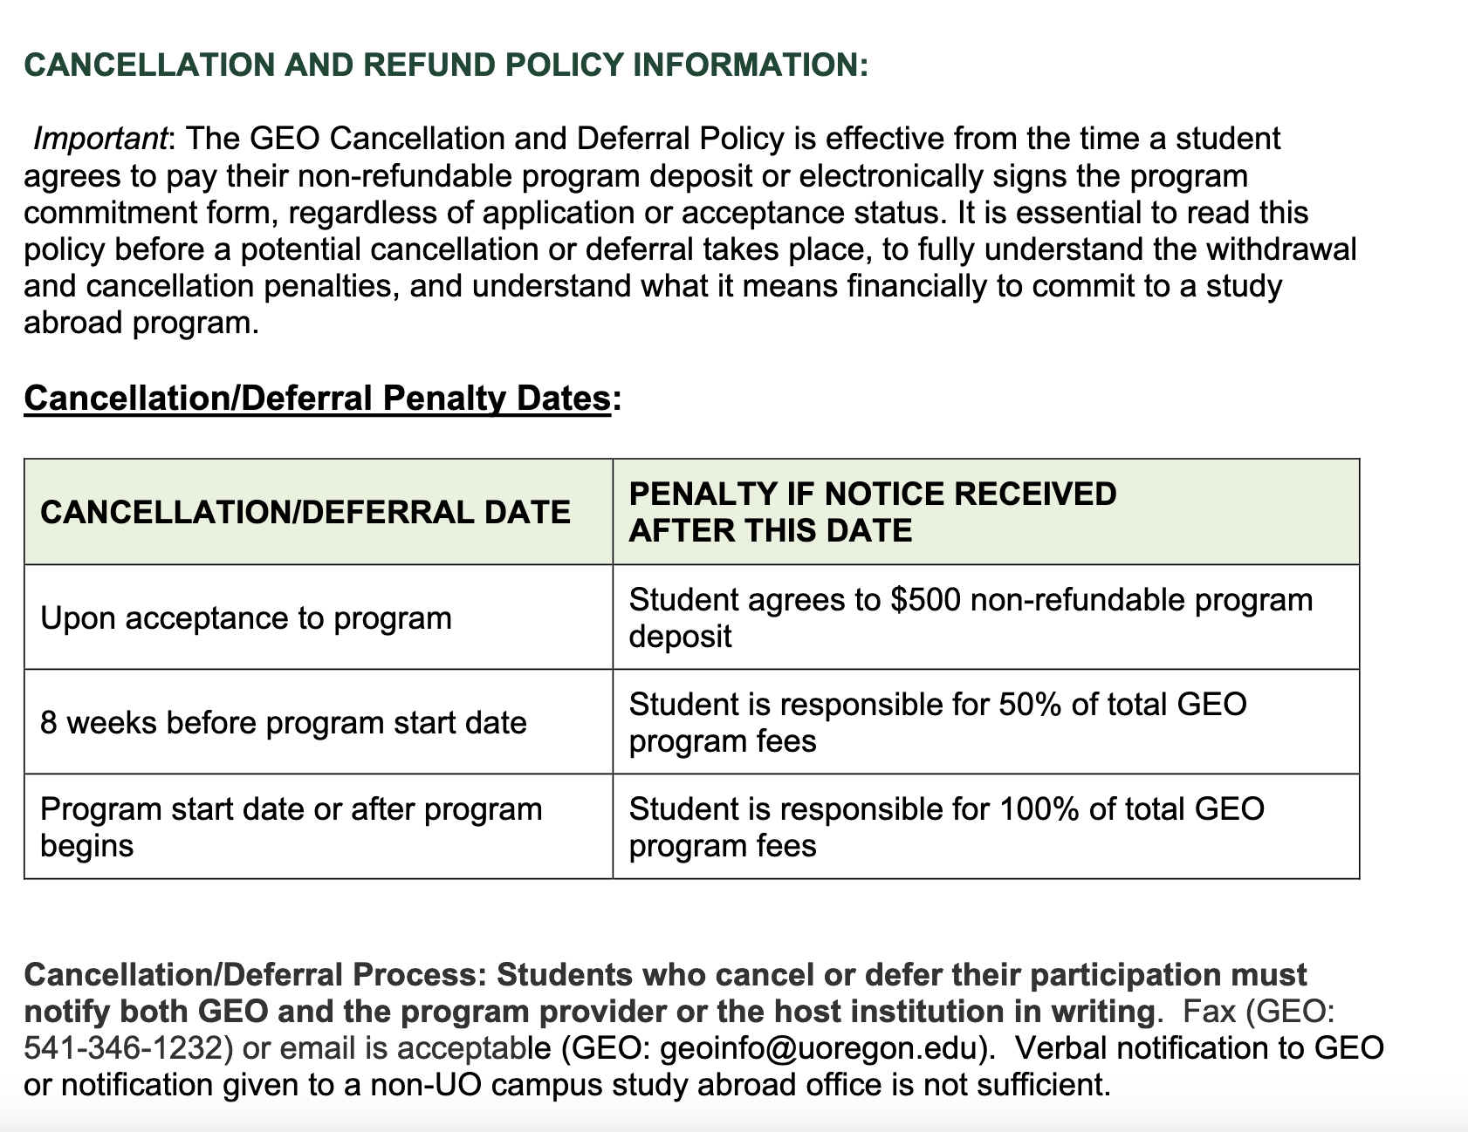
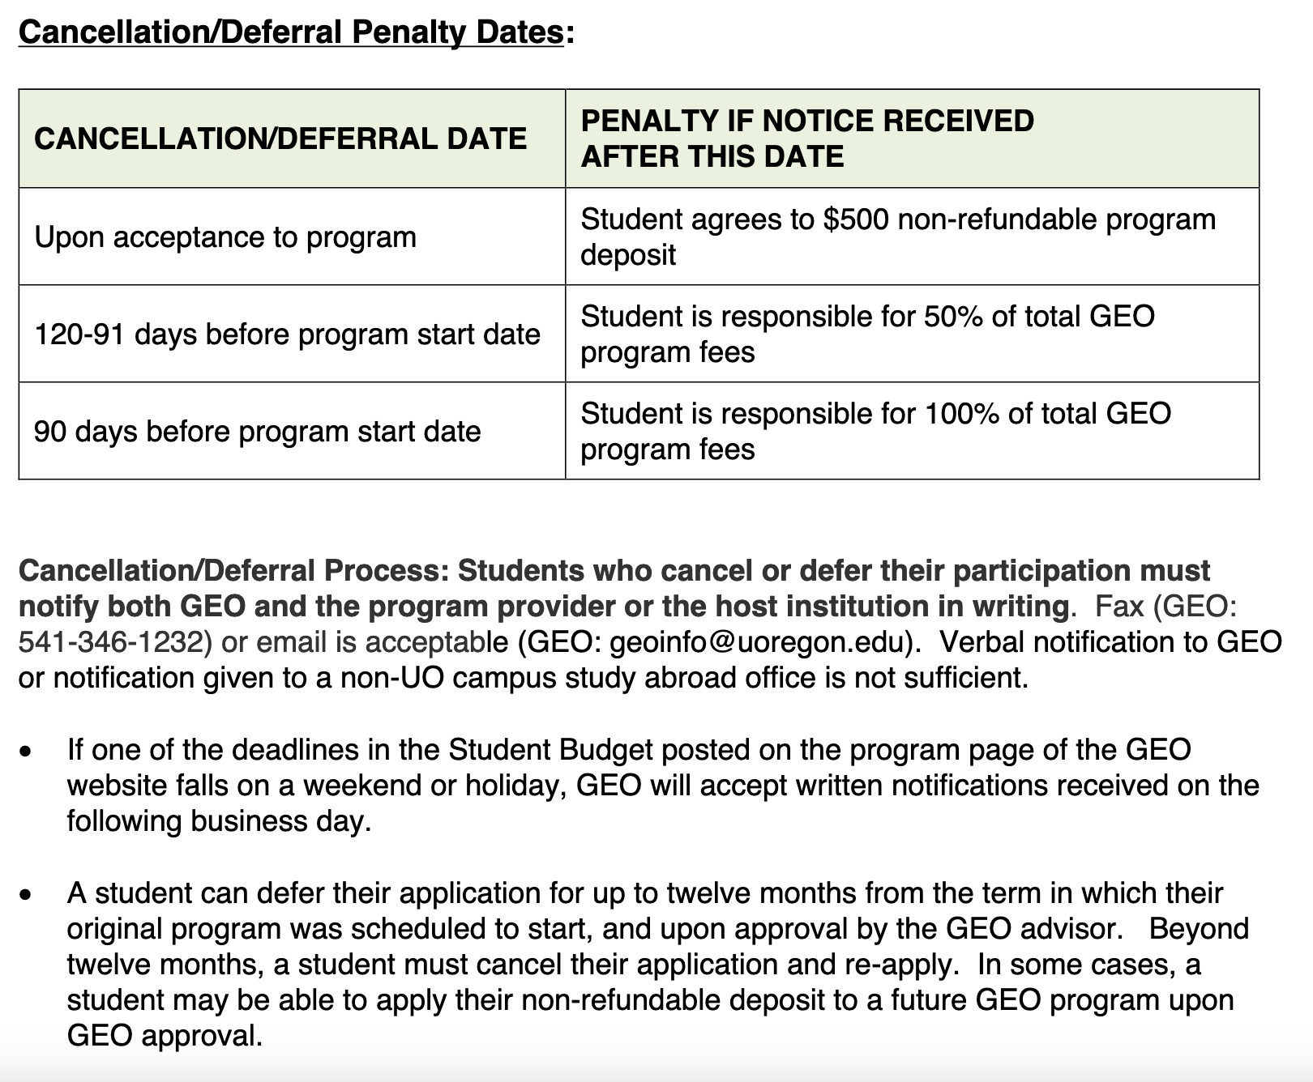
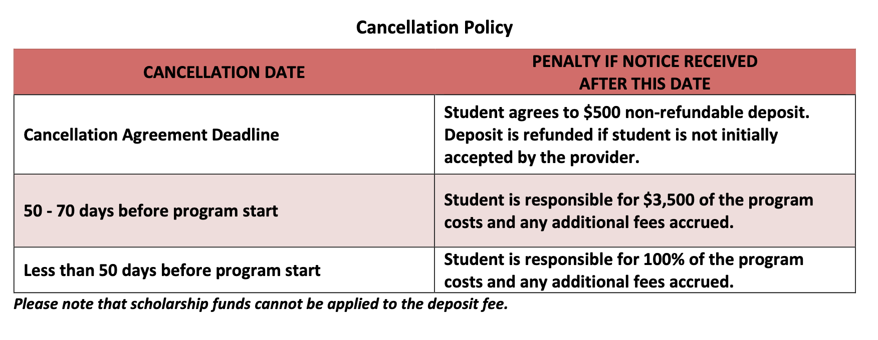

Slide 16
Why Budgeting is Important
Facilitates managing and prioritizing estimated expenses
Ensures you have sufficient funds for the entirety of the program
Reduces financial stress
Don’t spend money all at once
Prepares for unexpected costs
Encourages financial independence
Notes:
Myrna

Slide 17
Staying on Budget: Tips
Research the cost of living
Understand the local cost of housing, food, transportation and other daily needs in your host country
Understand local currency and exchange rates
Set a Realistic Budget and Stay on Schedule
Break down your budget into categories (e.g., accommodation, food, transportation, entertainment, and emergency savings) and stick to the limits you set for each category to avoid overspending
Plan for Lunch/Dinner
Understand your spending habits
Embrace a Money-Conscious Lifestyle
Use public transportation, cook your meals (and/or take advantage of meals included in your program), limit nights out, and opt for free or low-cost cultural activities, etc.
Track your spending
Plan for unexpected expenses
Notes:
Myrna

Slide 18
Budgeting for Personal Travel
If traveling to another city/country while studying abroad, consider the following:
Transportation Costs
How to get there and how to get around while there
What do you have?
Meals
Accommodation
Entertainment
Miscellaneous Expenses
Souvenirs
Notes:
Myrna

Slide 19
Maximizing Budget
Choose a bank that offers low or no interest rate
Ask locals for restaurant recommendations
Reconsider going out!
Inquire about local student or youth deals
What are you interested in? If you're interested, it's worth the money
Budgeting is about having the money to do what you want to do abroad
Notes:
Myrna

Slide 20
Questions to Ask Yourself
Does my bank have foreign transaction fees?
What is the cost for purchases/ ATM withdrawals?
Is cash better to use?
What is my weekly/daily budget?
Food, transportation, and additional living expenses
Do I have dietary restrictions?
Will that increase the cost?
What is the kitchen/food situation?
If I have a kitchen, what does it have?
Notes:
Myrna

Slide 21
Questions to Ask Yourself
5. Have I submitted the Financial Aid Adjustment Form?
6. What are my normal spending habits?
Be realistic and be flexible
7. What can I do before my departure to ensure I will be
financially stable while studying abroad?
Research, plan, save!
8. What are my total available funds?
- Scholarships
- Financial Aid
- Savings
9. Do I have an emergency fund?
Notes:
Myrna

Slide 22
TRIVIA QUESTION
What are three ways you can work to stay on a budget?

Slide 23
Scholarships & Financial Aid
What scholarships exist?
GEO Scholarship and Finance page
Merit, Financial Need, First Gen, Disability, etc.
When are they due?
Some are once a year, some are based on the term you study abroad
What do you need to apply?
An essay? A recommendation?
Do my UO Scholarships apply?
Maybe! Check the language (Ex. some specify only academic year)
Does Financial Aid apply?
Yes!
Notes:
Myrna

Slide 25
Application Breakdown
Financial Need and Merit —> Evaluate Financial Aid offer and Transcript
Merit —> Evaluate Transcript
How to write an essay
1-2 pages single spaced —> Not academic paper, just have good grammar
Introduction (Short, simple)
Academics (How program will help degree, why you are interested)
Professional Aspirations (How you imagine this shaping post-college life)
Financial Need (Why do you need money)
Personal Reasons/other information (Anything else you want to say?)
Conclusion (Short, simple)
Notes:
Myrna

Slide 26
Notes:
Myrna

Slide 27
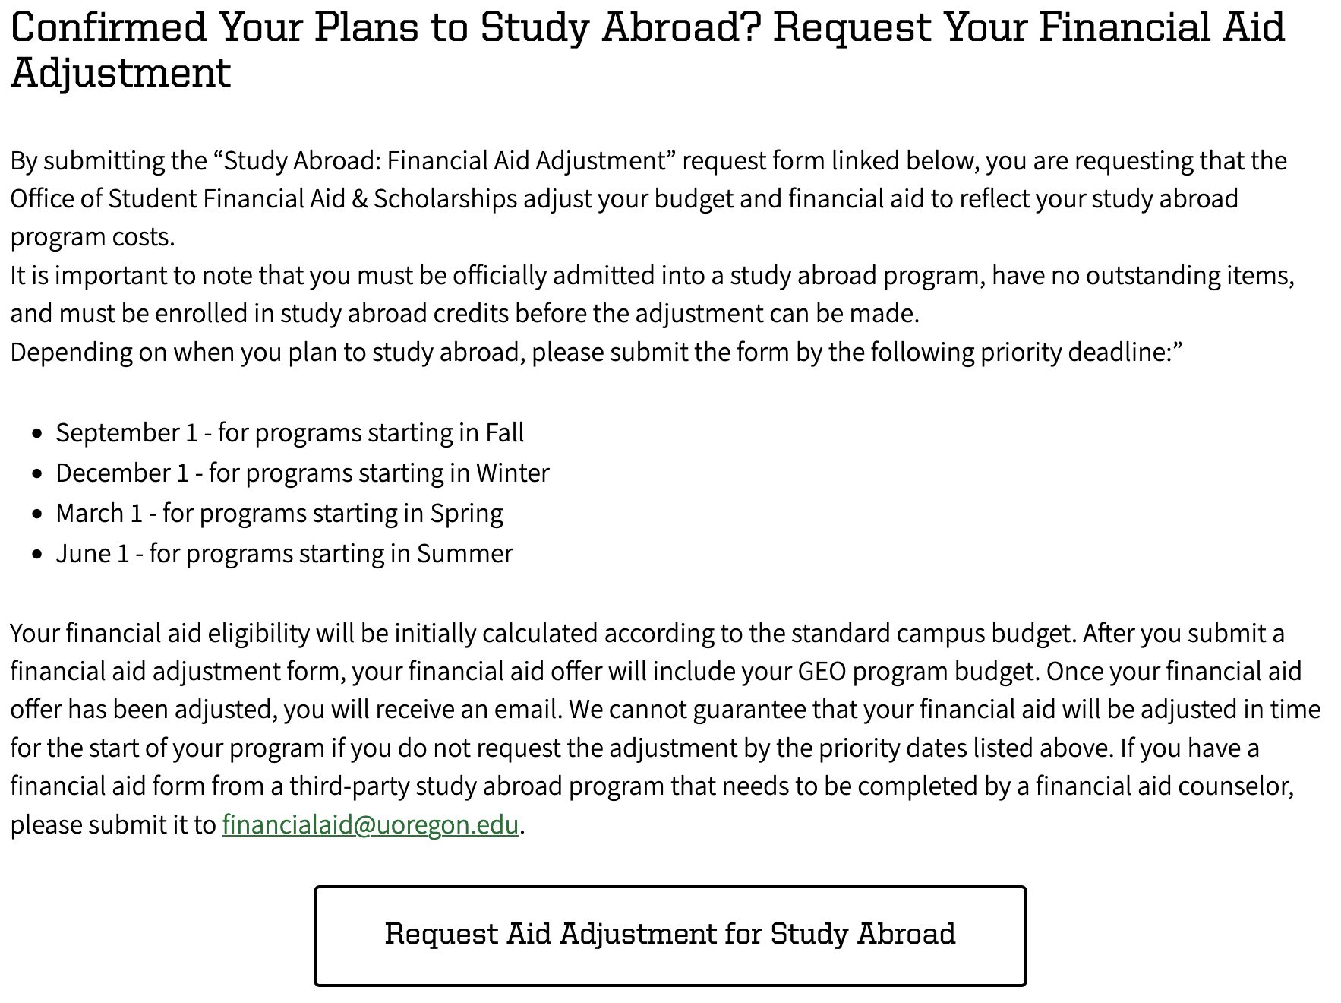

Slide 28
Questions?
If you registered, I will automatically send you the materials from today. If you did not register, do so now.
Notes:
Both

