Slide 1
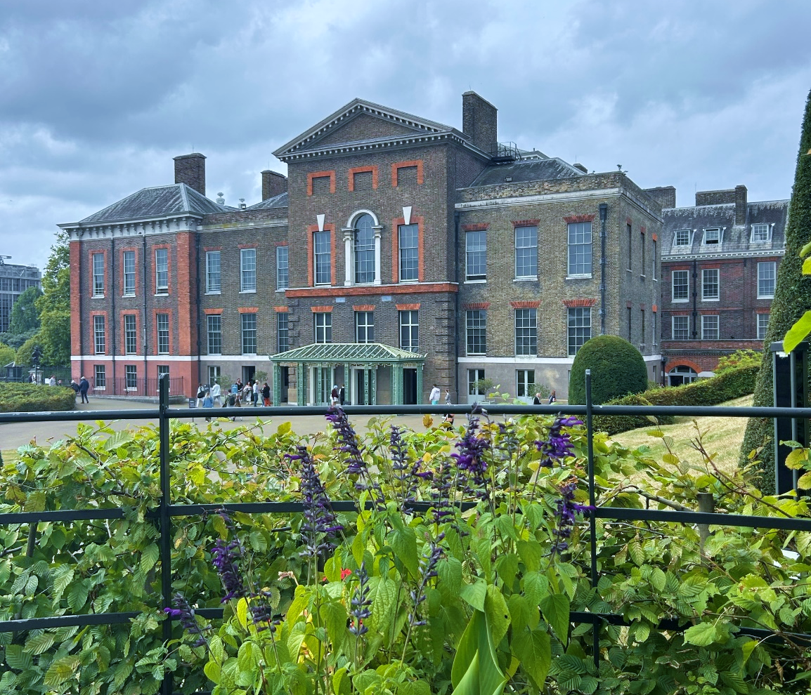
1ST-TIME TRAVELERS:
TOOLS TO THRIVE ABROAD

Slide 2
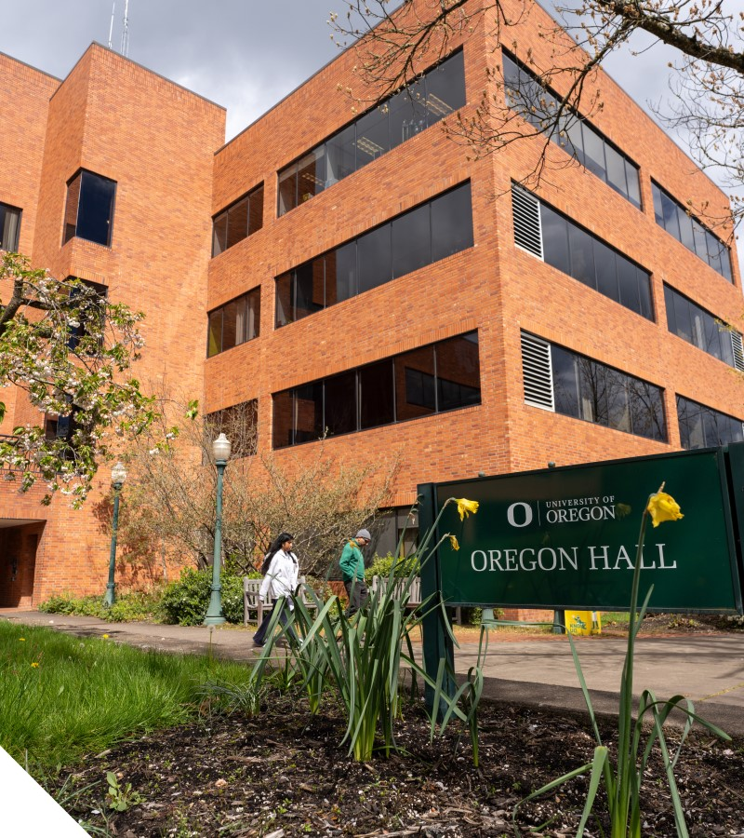
GEO CONTACTS
Myrna Najera Perez
mnajerap@uoregon.edu
300 W Oregon Hall
Bernice S. Krakani
berniceo@uoregon.edu
300 W Oregon Hall
Global Education Oregon
geoinfo@uoregon.edu
300 W Oregon Hall

Slide 3
AGENDA
This workshop will focus on addressing students' concerns about traveling abroad for the first time. The workshop will be student-centered, featuring a discussion where students can express their concerns, share what excites them about their destination, and strategize solutions to potential challenges. Key topics we will explore include concerns about first-time travel, managing uncertainty, and identifying additional resources needed before studying abroad.

Slide 4
DISCUSSIONS
What are you most looking forward to experiencing in your study abroad program?
What specific goals are you hoping to fulfill by participating in your study abroad program (e.g., learning a new skill, completing an academic requirement, etc.)?
What are your biggest questions about the logistics of travel (e.g., transportation, accommodation, meals)?

Slide 5
GEO STUDENT GUIDE
The GEO Student Guide is designed to help you prepare for a successful study abroad experience—please review thoroughly prior to your program start date.
INSERT LINK HERE
https://geo.uoregon.edu/student-guide

Slide 6
MONEY: TIPS
Budget
Research average costs at your study abroad site
Create a realistic budget for yourself: meals, transportation, entertainment, etc.
Track your daily spending
Understand Currency Exchange
Be aware of current exchange rates
Be aware of conversion fees
Ask your financial institutions what their foreign transaction fees are
Cards vs Cash
Does your study abroad site predominantly rely on physical currency, or have they moved to a cashless system?
Notify your bank you’ll be studying abroad (+ travel dates). This way, you can use your credit/debit cards while abroad.
If withdrawing cash, avoid high-fee ATMS—use ones inside banks
Manage US Expenses while Abroad
If leasing, plan for rent
Cancel or pause subscriptions (e.g., gym memberships, meal delivery services, etc.)
Set up autopay to manage credit card payments and/or other bills

Slide 7
TRAVEL
Obtain required documentation in a timely manner
Passport, visa, immunization, etc.
Ensure your passport is valid for at least 6 months after your program end date
If traveling with a non-US passport, notify GEO ASAP
Booking Flights
Research airline policies
Purchase travel insurance
Purchase through a secure website, such as Google Flights or official airline websites

Slide 8
TRAVEL TIPS
Carry digital and hard copies of your travel documents (passport, visa, etc.)
Share your travel itinerary with trusted family/friends
Ensure liquids and other carry-on items are TSA-compliant
Keep prescription medication in its original container and carry no more than the needed quantities in your carry-on
Pack layers and comfortable walking shoes
Pack sensibly
Pack a portable power bank and universal adapter
Don’t forget your laptop/laptop charger or other electronics you rely on day-to-day for academic and/or communication purposes
Get to the airport early!

Slide 9
SAFETY
Keep your valuables secure
Be vigilant while on public transportation
Drink responsibly, know your drinking limit, and always keep an eye on your drink
Go out as a group and return as a group
Be mindful of local laws and customs
Can Possession, consumption, and distribution of cannabis lead to criminal charges?

Slide 10
RESOURCES
Smart Traveler Enrollment Program (STEP)
Free service to allow U.S. citizens and nationals to enroll their trip abroad so the Department of State can accurately and quickly contact them in case of emergency
Department of State
Responsible for the country's foreign policy and relations
Travel Advisories
Centers for Disease Control – Study Abroad
US Students Abroad

Slide 11
DISCUSSIONS
What are some concerns you have about traveling for the first time?
How do you typically manage uncertainty or unexpected situations? How can these strategies help you on your program?
What information or resources do you feel you still need before your trip?

Slide 12
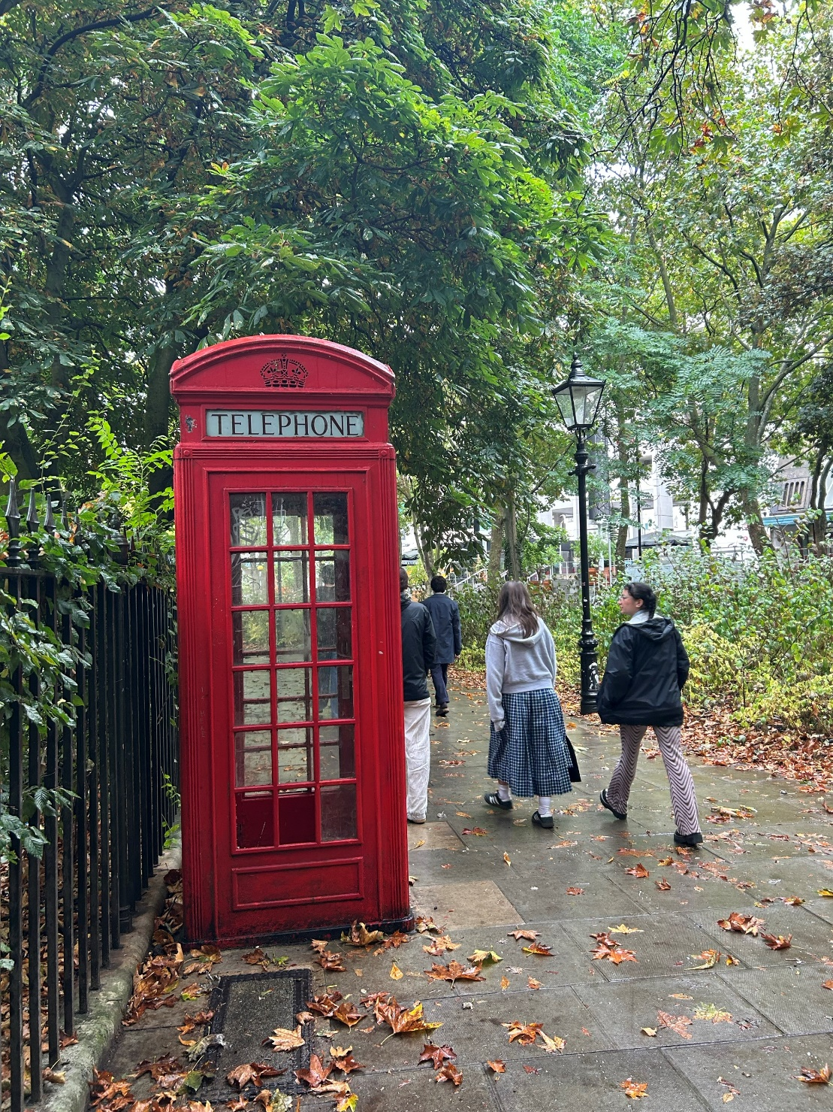
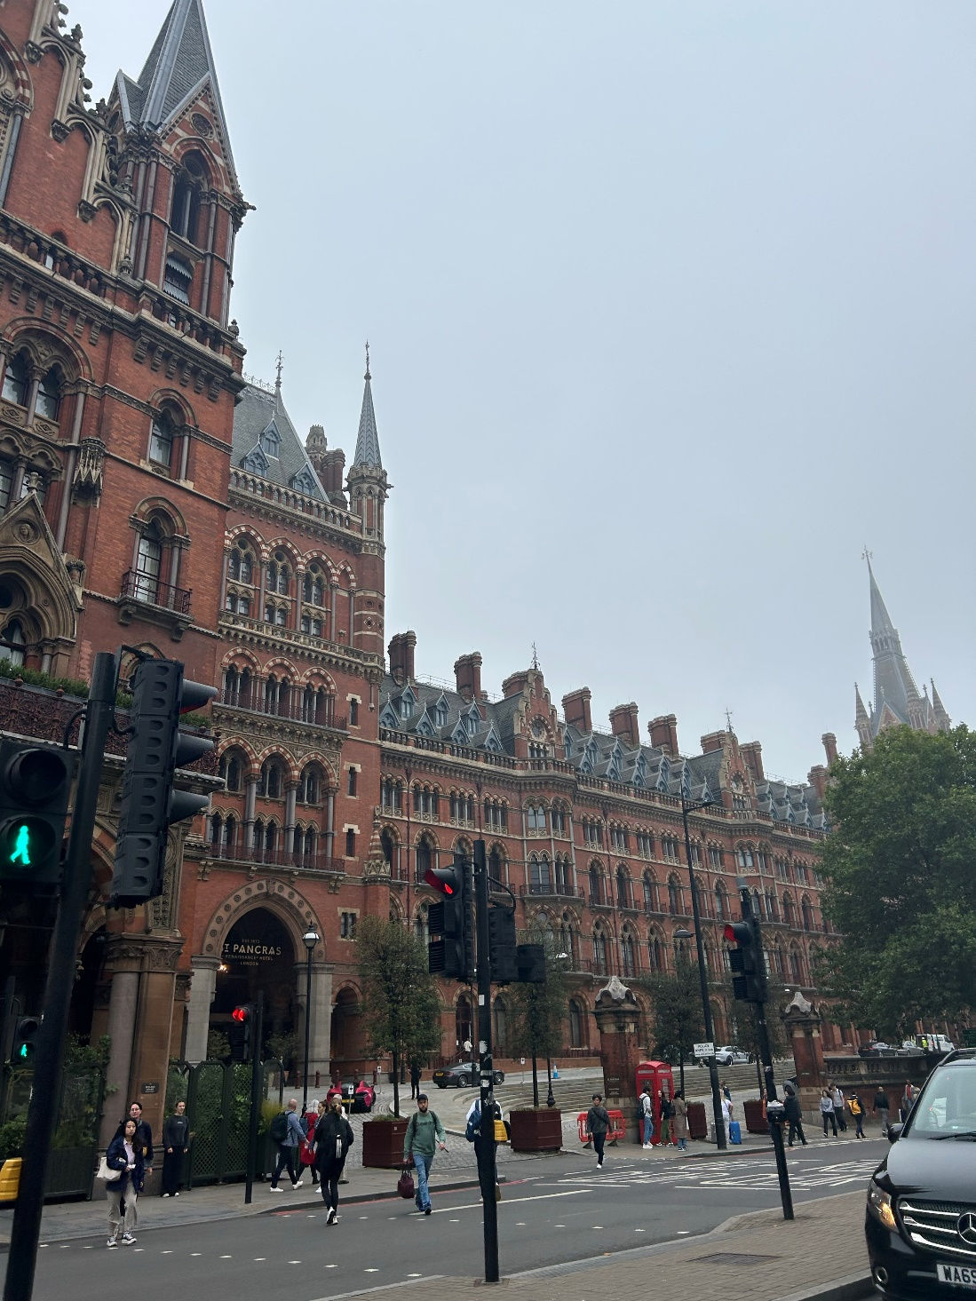
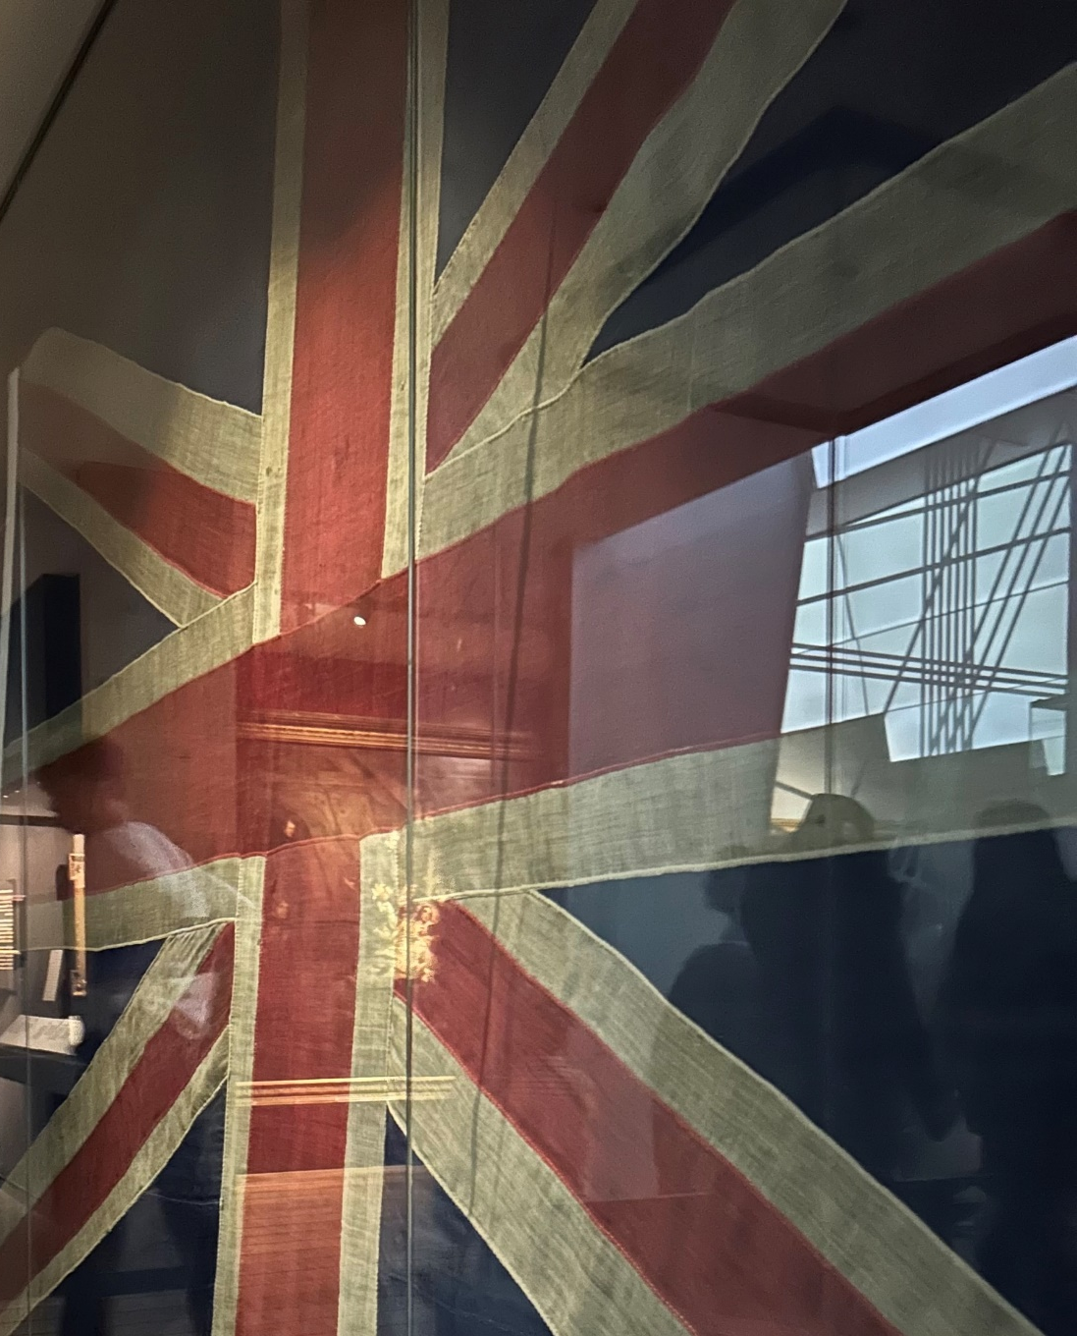
QUESTIONS?

