Slide 1
Making the Most of Your Internship Abroad
A conversation with program alumni

Slide 2
Meet your Alumni
Introductions
Guided Questions
Open Q&A

Slide 3
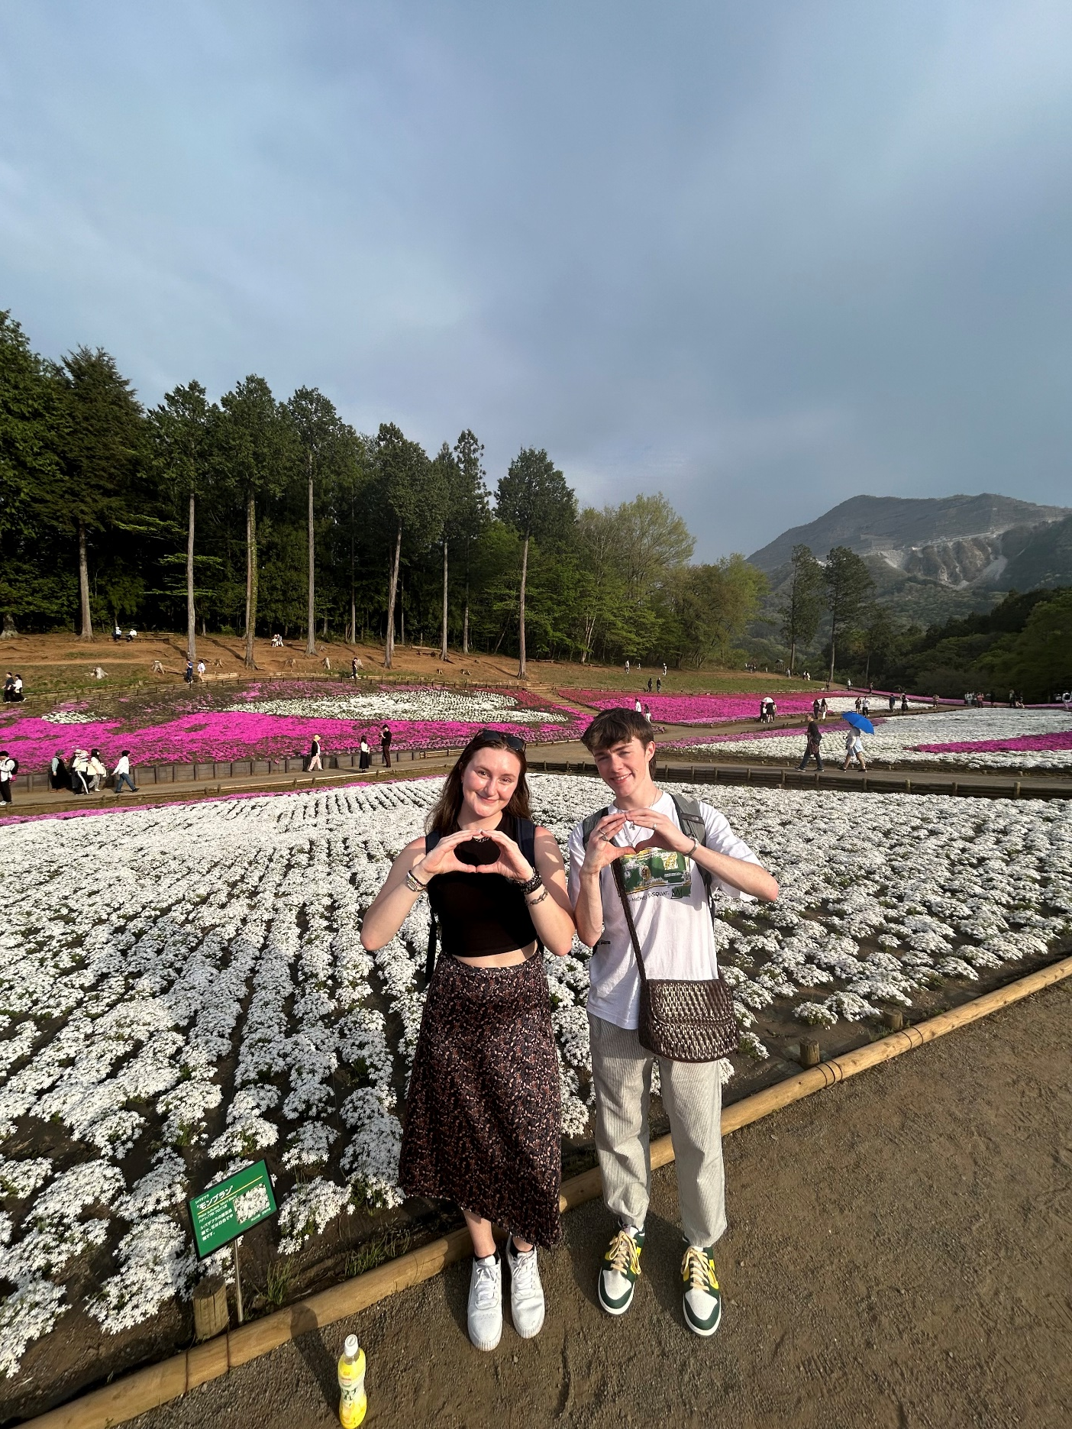
Introductions
Alumni:
What Program did you do? (When and where?)
What is your major?
One fun fact about you?

Slide 4
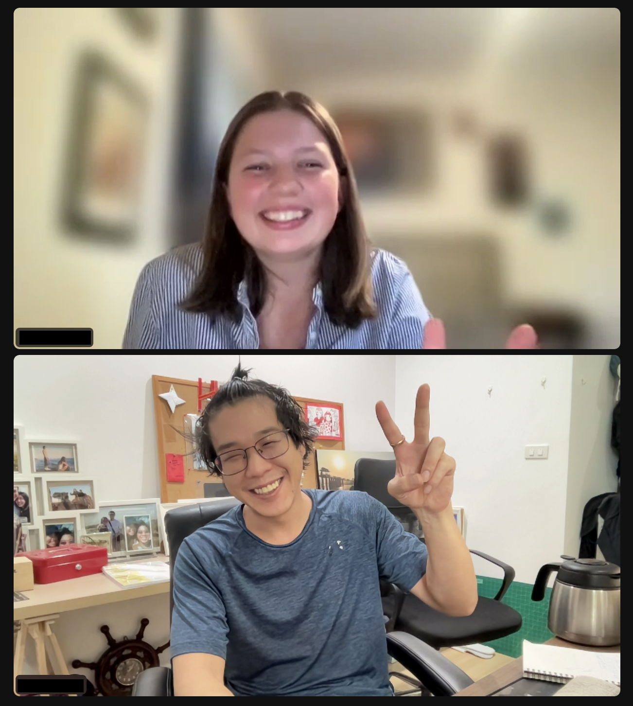
Question 1
What did a typical day look like at your workplace, and a typical week?

Slide 5
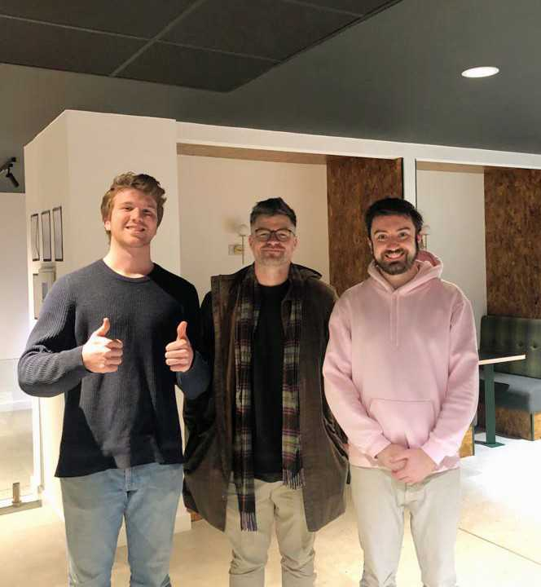
Question 2
What, if any, challenges or culture shock did you experience while interning?

Slide 6
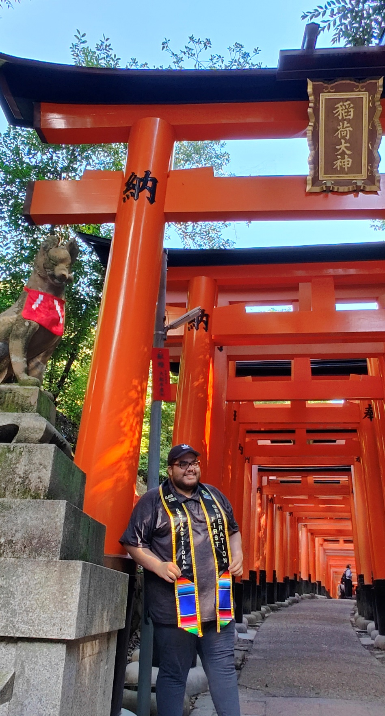
Question 3
What is one project or deliverable you worked on that you feel proud of?

Slide 7
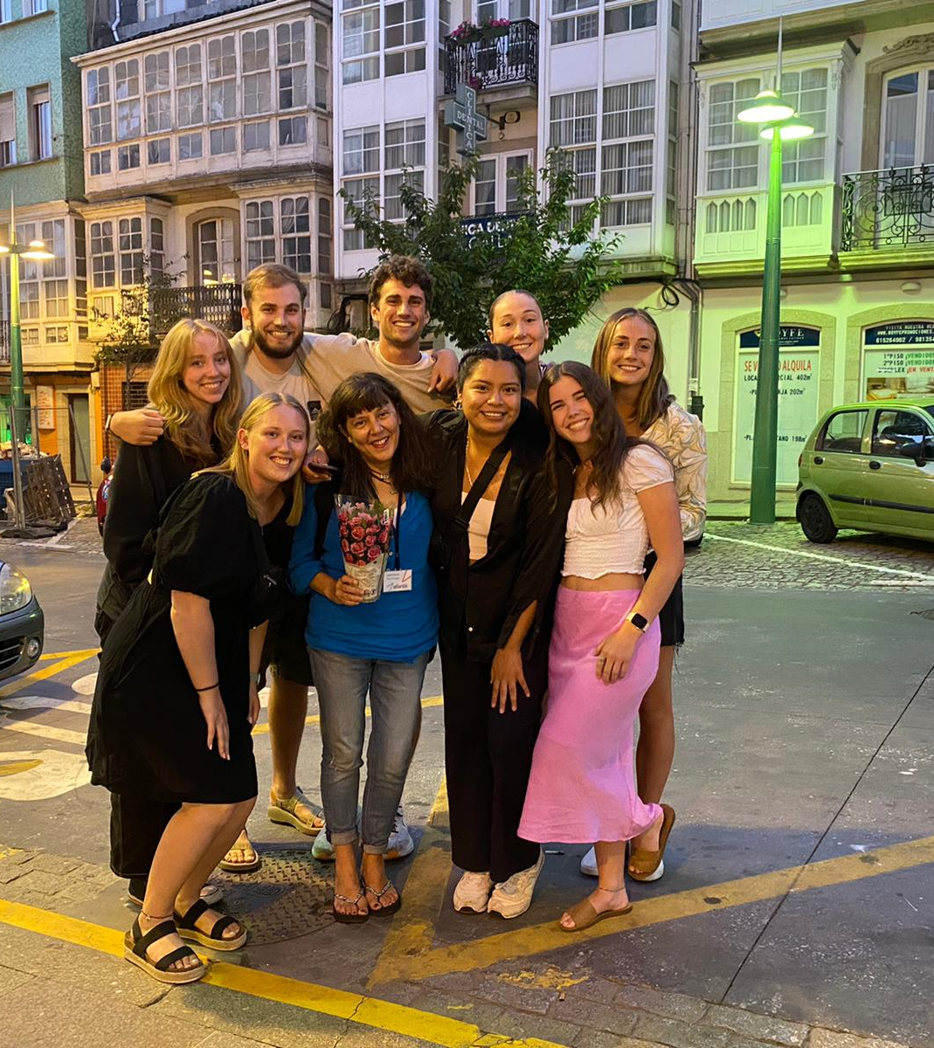
Question 4
How did this internship prepare you for your future career?

Slide 8
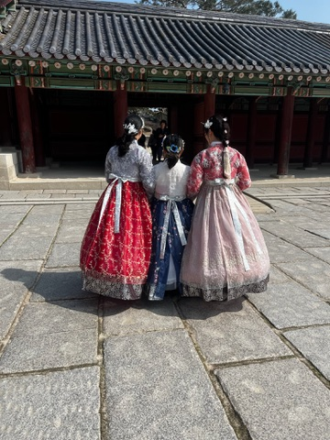
Question 5
How much professional support did you receive on your program while you were abroad (outside of your workplace)?

Slide 9
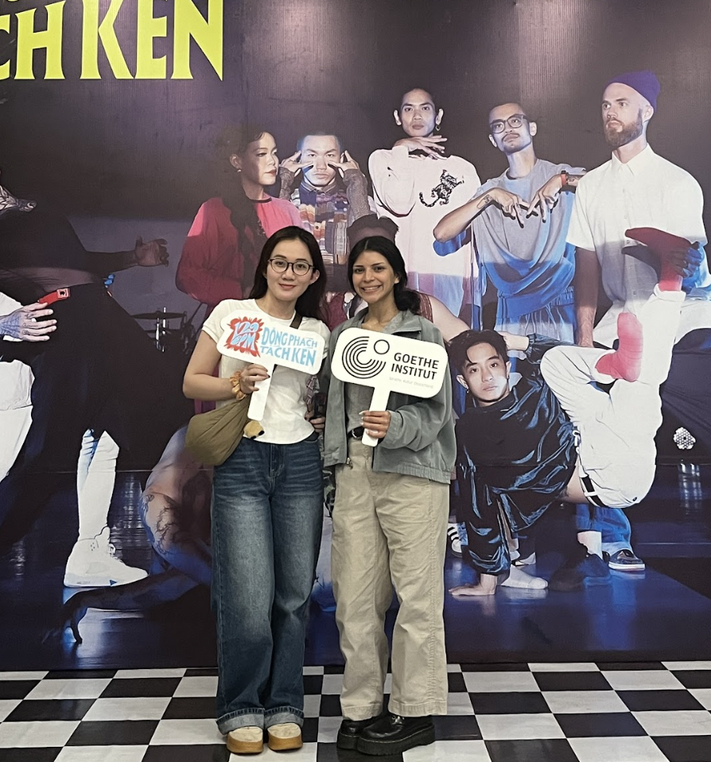
Question 6
What do you wish you would have known before the program start?

Slide 10
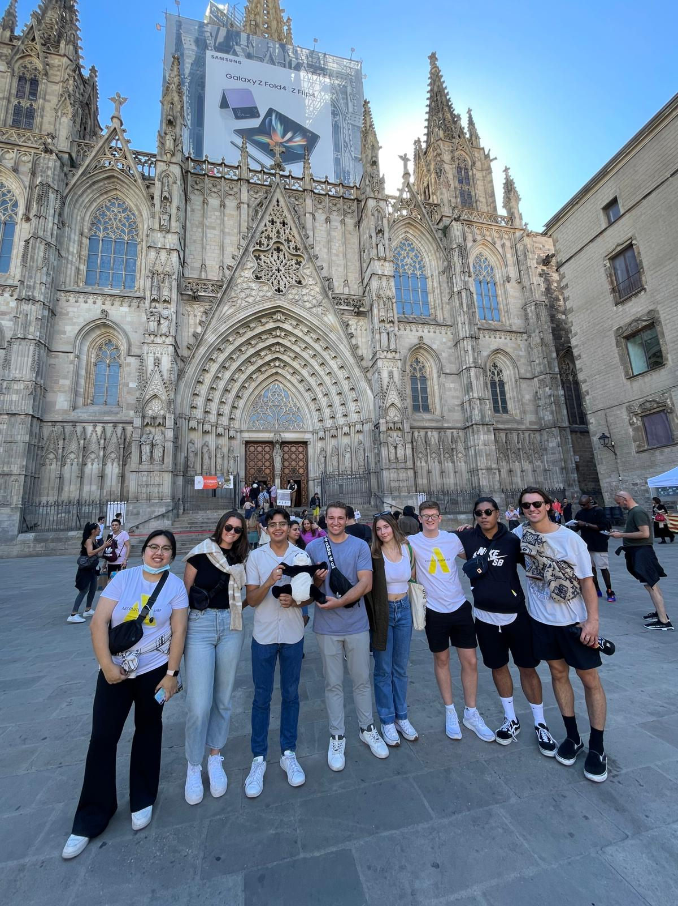
Question 7
What was your work life balance like?

Slide 11
Question 8
Did you experience any reverse culture shock coming home?

Slide 12
Your Turn!
What questions do you have for our panelists?

Slide 13
Meet your Alumni
Introductions
Guided Questions
Open Q&A

