Slide 1


From the World to the Workplace: Leveraging Your Global Experience
GEO, GlobalWorks, and UO Career Center
May 20, 2025

Slide 2

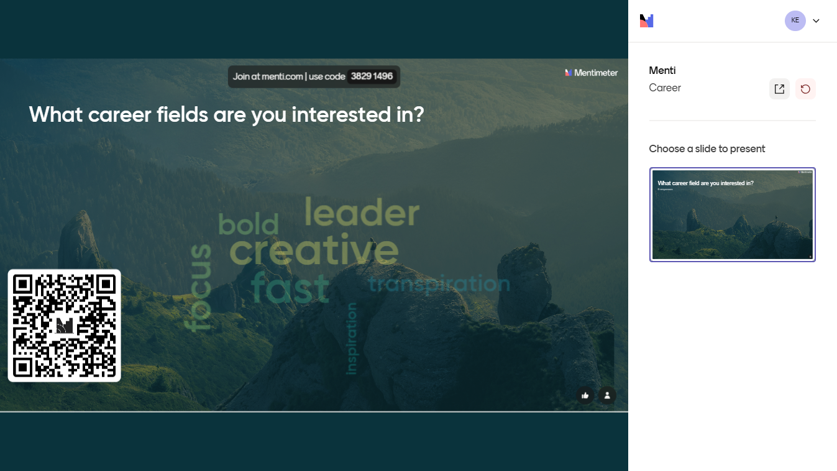
Let’s get started!
What career field are you interested in?

Slide 3
What Employers Are
Looking For?

Slide 4

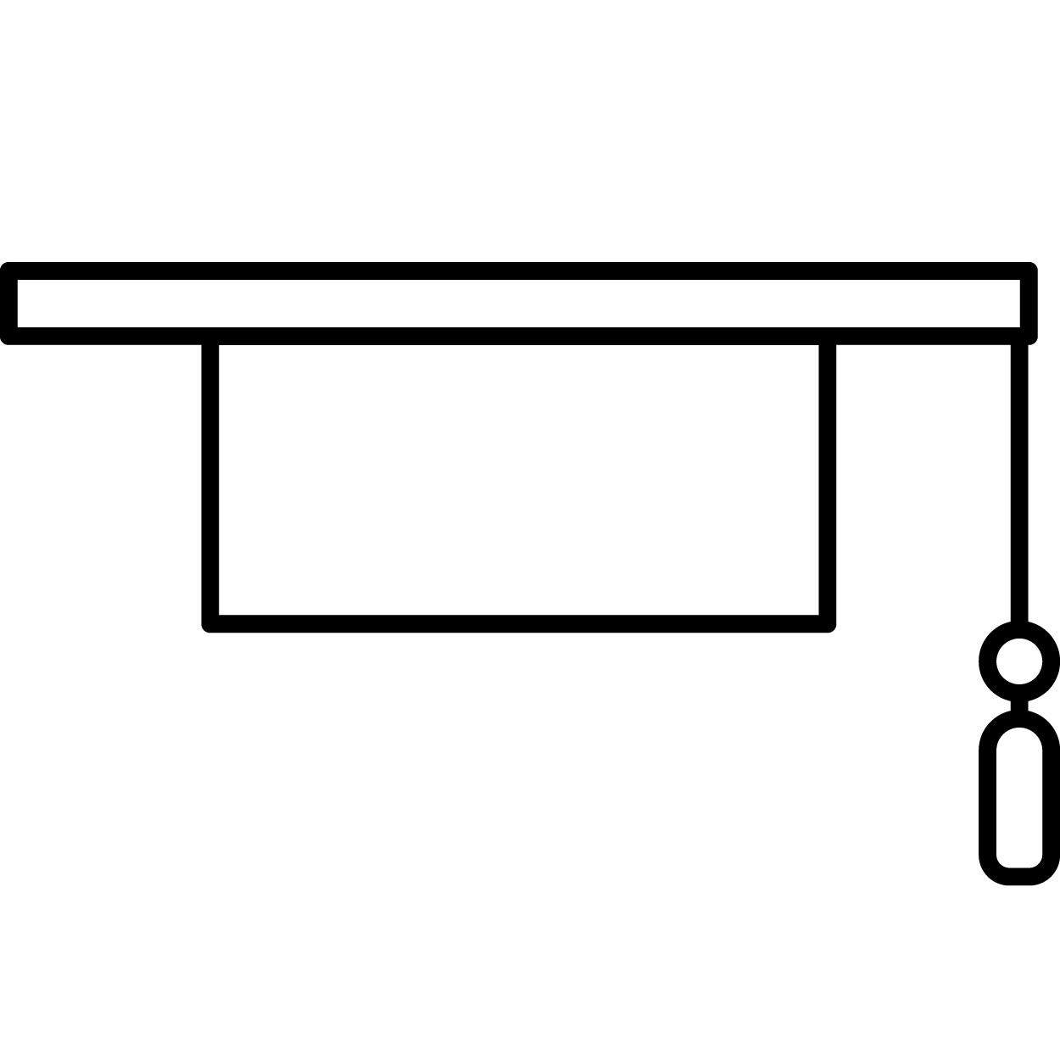







NACE Career Competencies
Career & Self-Development
Communication
Critical Thinking
Equity & Inclusion
Leadership
Professionalism
Teamwork
Technology
UNIVERSITY OF OREGON #

Slide 5
NACE Career Competencies
Career & Self-Development
Sample behavior: Display curiosity; seek out opportunities to learn.
Interview example: "While onsite at my fresh water well-drilling organization, HydroClean, I asked one of the on-site drilling specialists about the science behind our wells. They were willing to take an hour of their time to show me the inner-workings of the filtration system. This helped me to articulate the need and help educate young people in the classroom about the importance of consuming clean water and the community need for public health interventions."
Skills developed: (these translate to resume bullet points) • Ability to articulate complex technological systems to a variety of audiences and skill levels.
UNIVERSITY OF OREGON #

Slide 6
NACE Career Competencies
Communication
Sample behavior: Communicate in a clear and organized manner so that others can effectively understand
Interview example: "I served as the liaison between the technologists and programmers and the salespeople who were in charge of researching, and selling, the end software product. Being able to translate the use-cases for each individual complex product in order to help the salespeople, especially new hires, understand the product was integral to our company's success."
Skills developed: • Frame communication with respect to diversity of learning styles, varied individual communication abilities, and cultural differences.
UNIVERSITY OF OREGON #

Slide 7
NACE Career Competencies
Critical Thinking
Sample behavior: Gather and analyze information from a diverse set of sources and individuals to fully understand a problem
Interview example: "In my previous role – we always submitted our physical timesheets weekly and the HR Manager had to consolidate them using a scanner and .PDF stitching technology. Sometimes timesheets went missing or were forgotten. When I asked why we did this – nobody really knew. It was an outdated practice that was put in place 20 years ago. I decided to look into alternative solutions and found a content management system that could do much of this work automatically – saving both hourly employees and the HR Manager up to 10 hours per week and increasing office efficiency."
Skills developed: • Effectively communicate actions and rationale, recognizing the diverse perspectives and lived experiences of stakeholders.
UNIVERSITY OF OREGON #

Slide 8
NACE Career Competencies
Equity & Inclusion
Sample behavior: Advocate for inclusion, equitable practices, justice, and empowerment for historically marginalized communities.
Interview example: "Every week in meetings at my previous job, we would watch instructional videos on new product. The videos were low volume and didn't include subtitles. I noticed my coworker, who is hard of hearing, struggling to focus and hear. I pulled them aside and asked them if they needed an accommodation – and they mentioned how useful that would be. I used my position as Assistant Manager to both order an external speaker and utilize a voice-to-text software to allow subtitled to be generated for the videos."
Skills developed: • Identify resources and eliminate barriers resulting from individual and systemic racism, inequities, and biases.
UNIVERSITY OF OREGON #

Slide 9
NACE Career Competencies
Leadership
Sample behavior: Serve as a role model to others by approaching tasks with confidence and a positive attitude.
Interview example: "As a member of my college photo club, I had an idea to create a partnership with the local newspaper. The Director of the group promoted me to Associate Director, and I managed a team of 5 photographers as they took photos on an internship basis with the paper."
Skills developed: • Plan, initiate, manage, complete and evaluate projects.
UNIVERSITY OF OREGON #

Slide 10
NACE Career Competencies
Professionalism
Sample behavior: Maintain a positive personal brand in alignment with organization and personal career values.
Interview example: "When tabling at client events for my previous organization, I made a point to remain positive even in difficult scenarios and provided detailed information, a clean and presentable table set-up, and extra materials in case we ran out."
Skills developed: • Have an attention to detail, resulting in few if any errors in their work.
UNIVERSITY OF OREGON #

Slide 11
NACE Career Competencies
Teamwork
Sample behavior: Effectively manage conflict, interact with and respect diverse personalities, and meet ambiguity with resilience.
Interview example: "I noticed my teammate struggled when it came to a certain task in regards to creating spreadsheets to represent out quarterly data. Since we share a job title, and I enjoy spreadsheet work, I offered to trade them some of my tasks as long as the Manager approved. The Manager agreed – and my teammate experessed delight in no longer having that task. In the end, everyone benefitted."
Skills developed: • Collaborate with others to achieve common goals.
UNIVERSITY OF OREGON #

Slide 12
NACE Career Competencies
Technology
Sample behavior: Use technology to improve efficiency and productivity of their work.
Interview example: "Because I am the only employee who had expertise in AI on my current team, I decided to hold twice-monthly Q&A sessions to get my team up to novice-level on ChatGPT. They admitted to being intimidated at first – but by the end, all of us were integrating AI practices into our workflows."
Skills developed: • Manipulate information, construct ideas, and use technology to achieve strategic goals.
UNIVERSITY OF OREGON #

Slide 13
Quiz: What fields, job titles, or sectors does international work experience apply to?
Answer: ALL OF THEM!
(international experience is experience...but just usually a bit more interesting)

Slide 14
Trivia Time!

Slide 15
RESUME ACTIVITY

Slide 16
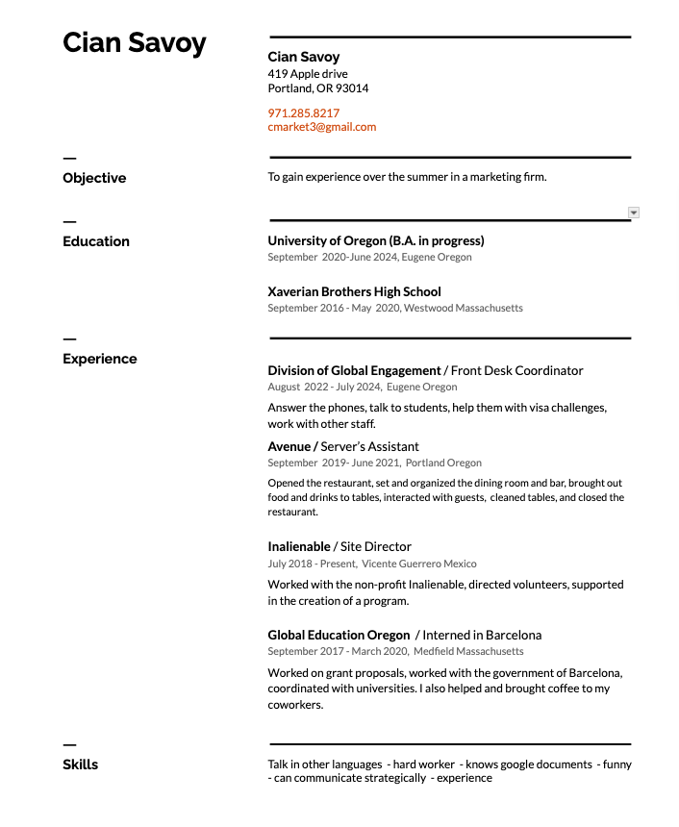
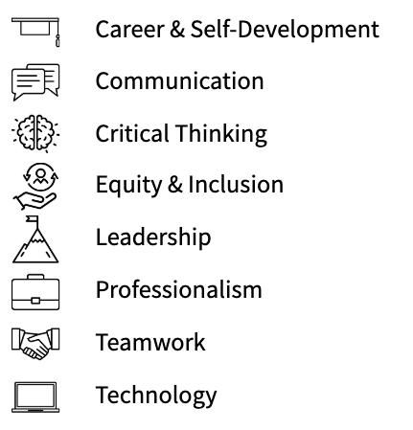
What can be improved from this resume?
Consider the NACE Core Competencies

Slide 17
What can be improved from this resume?
Spacing?
Relevant?
Impact/Numbers?
Cultural Communication?
Professional skills?

Slide 18
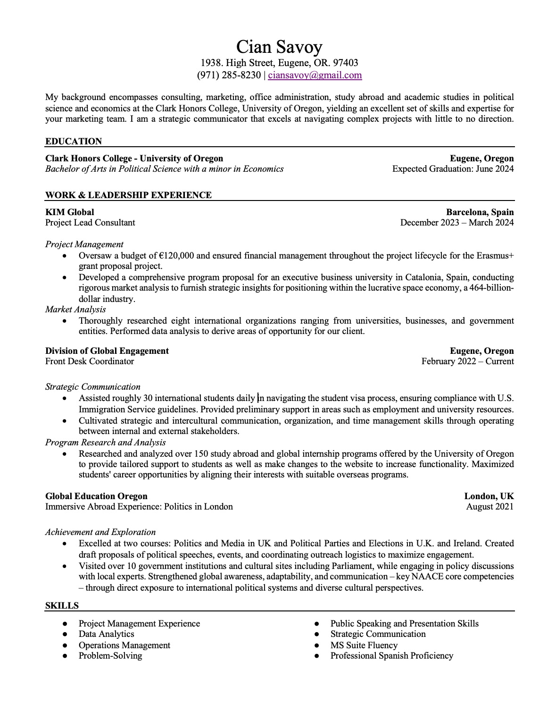
What positive changes were made?

Slide 19
What positive changes were made?
Adjusted format to utilize space
From just objective to objective + background (brief)
Specified objective with brief background and purpose
Refined relevant experience
Increased the numbers on resume to illustrate greater impact
Introduced more professional language in describing experiences
Showed experience in navigating environments with different cultures
Skills directly correlate with NACE core competencies

Slide 20
Interview Questions

Slide 21
Common Interview Questions
Tell me about yourself
Why should we hire you?
Why do you want to work for our organization?
Why do you want to work in this role /for this company?
Why do you want to work in this sector / industry?
Tell me about a time when you produced a creative solution to problem.
What are your strengths and weaknesses?
Where do you see yourself in five years?
Can you describe a challenging situation and how you handled it?
What motivates you?
How do you handle stress and pressure?
Do you prefer to work independently or as part of a team?
UNIVERSITY OF OREGON #

Slide 22
Common Interview Questions
STORYTELLING
Tell me about yourself
Why should we hire you?
Why do you want to work for our organization?
Why do you want to work in this role /for this company?
Why do you want to work in this sector / industry?
Tell me about a time when you produced a creative solution to problem.
What are your strengths and weaknesses?
Where do you see yourself in five years?
Can you describe a challenging situation and how you handled it?
What motivates you?
How do you handle stress and pressure?
Do you prefer to work independently or as part of a team?
UNIVERSITY OF OREGON #

Slide 23
STAR Method
STARR v. STAR
  Situation
  Task
  Action
  Result
  (Reflection)
Guidelines for answering interview questions – storytelling using real-life examples
Meant to be simple responses
Answer behavioral questions ("Tell me about a time when..., Give me an example of...., "Describe a situation when")
Notes:
Ryan – Add Content

Slide 24

Resources on Campus

Slide 25
Career Center Offerings
Individualized career coaching
Resume and cover letter workshops
Job search resources (Handshake and more)
BigInterview: Interview lessons and practice sessions
Departmental Career Services
Lundquist College of Business Mohr Career Services
College of Design Career Services
School of Journalism and Communications Career Services
School of Music and Dance

Slide 26
Trivia Time!

Slide 27
Thank you!

Slide 28


GEO Upcoming Workshops
https://geo.uoregon.edu/events

Slide 29
Title Slide Option 1 (UO Green)
Global Education Oregon
Firstname Lastname, University of Oregon
Month, Day, Year

Slide 30
Title Slide Option 1 (UO Green)
Global Education Oregon
Firstname Lastname, University of Oregon
Month, Day, Year

Slide 31

Title Slide Option 1 3A (Photo R)
Subtitle
Firstname Lastname, University of Oregon
Month, Day, Year

Slide 32

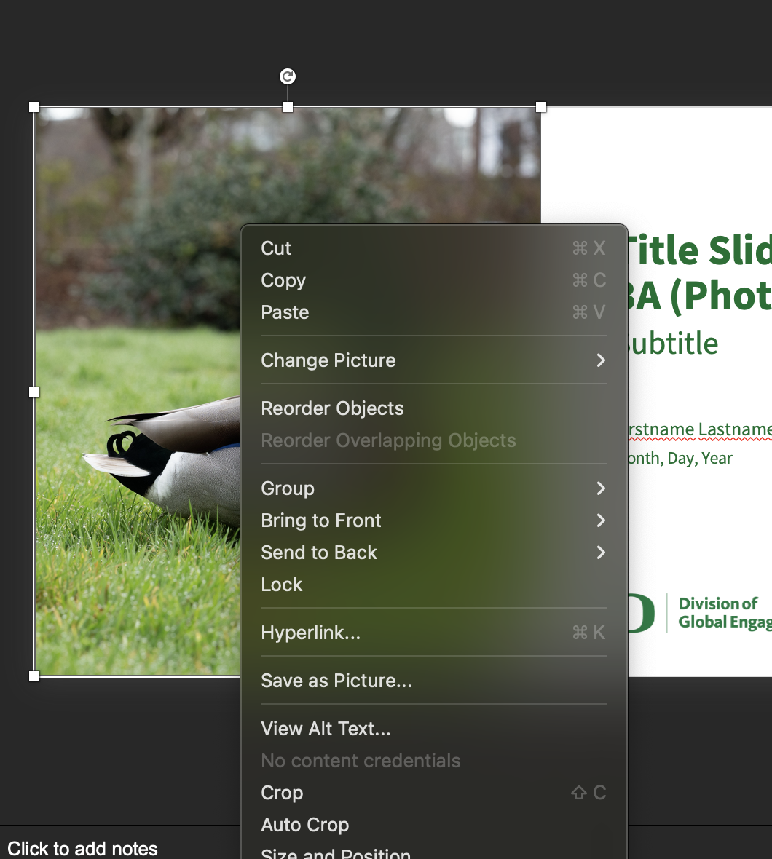
How to change the picture in this frame:
Right click the photo
Select ‘Change picture’
Choose the source to upload your photo i.e. desktop, online, stock, etc.

Slide 33
Divider Slide Option 1
(UO Green)

Slide 34
Divider Slide Option 2
(UO Yellow)

Slide 35
Divider Slide Option 2
(UO Yellow)

Slide 36
Text Only Slide
Headline: Source Sans Pro 40 pt, Body Text: Source Sans Pro 20
Use the University of Oregon’s brand colors found in the template’s color palette.
You can use bullet points or a long paragraph but keep text concise
UNIVERSITY OF OREGON #

Slide 37
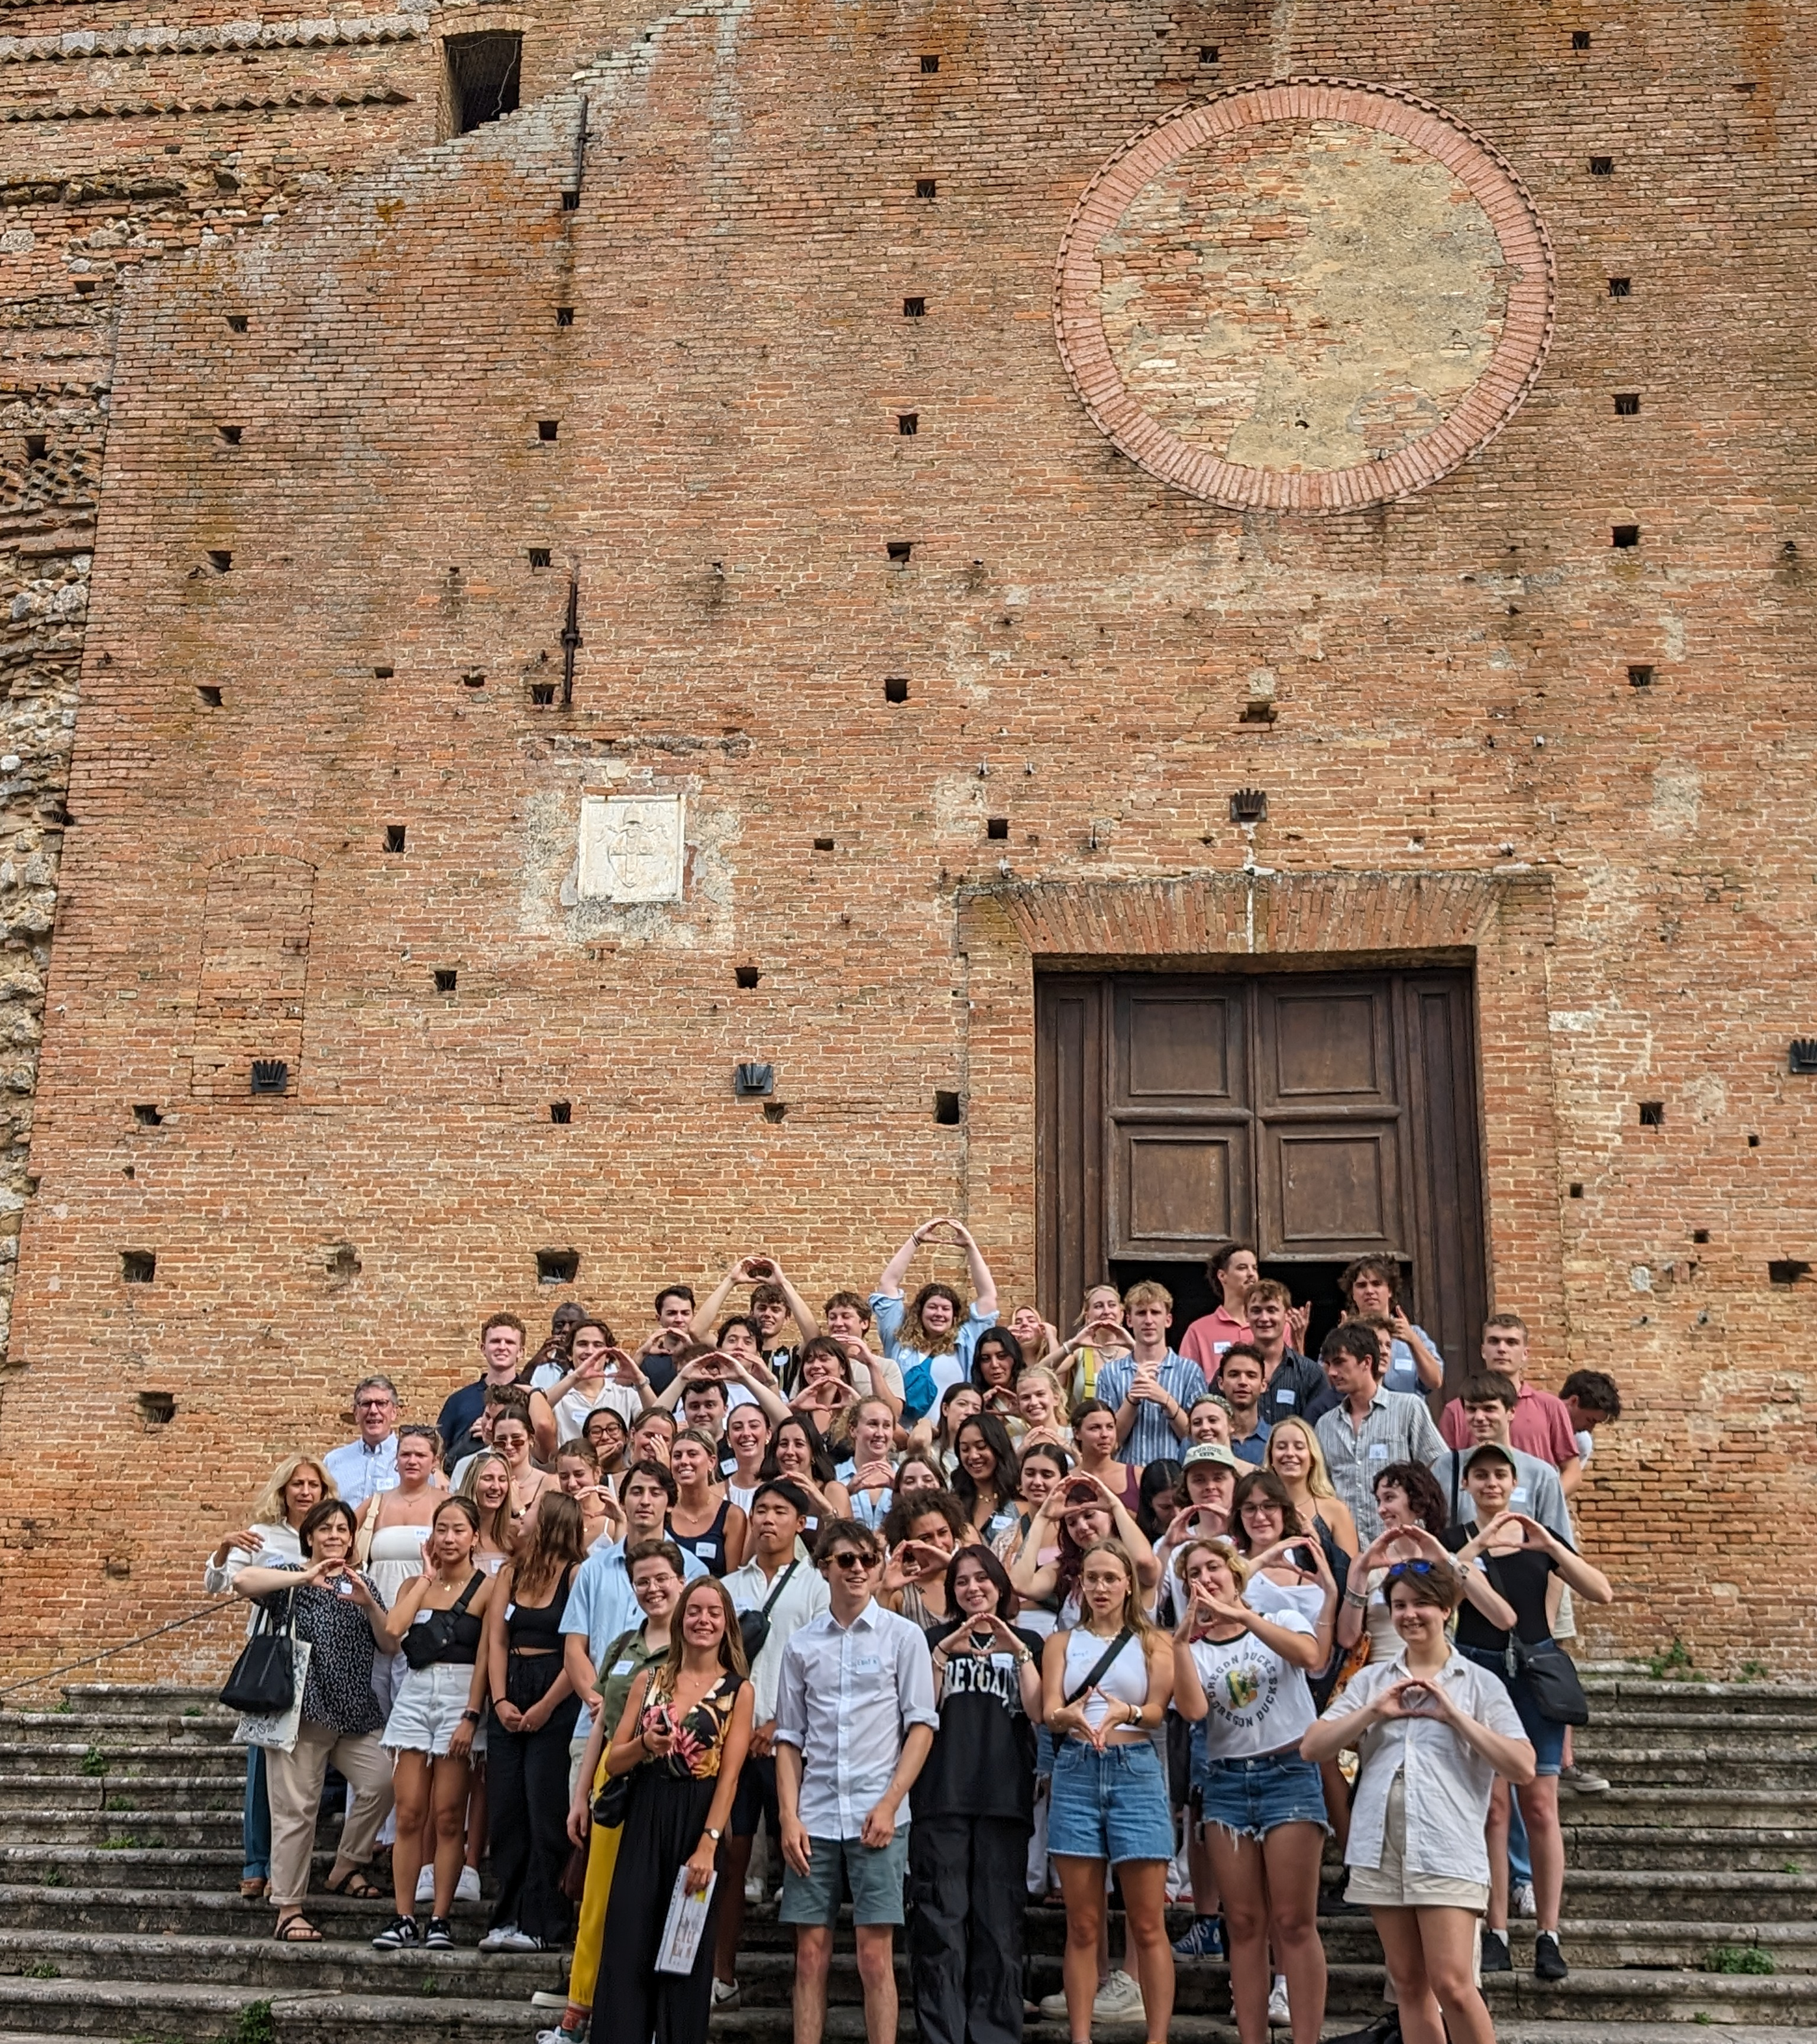
Smaller Picture Slide
Headline: Source Sans Pro 40 pt, Body Text: Source Sans Pro 20
Use the University of Oregon’s brand colors found in the template’s color palette.
You can use bullet points or a long paragraph but keep text concise
UNIVERSITY OF OREGON #

Slide 38
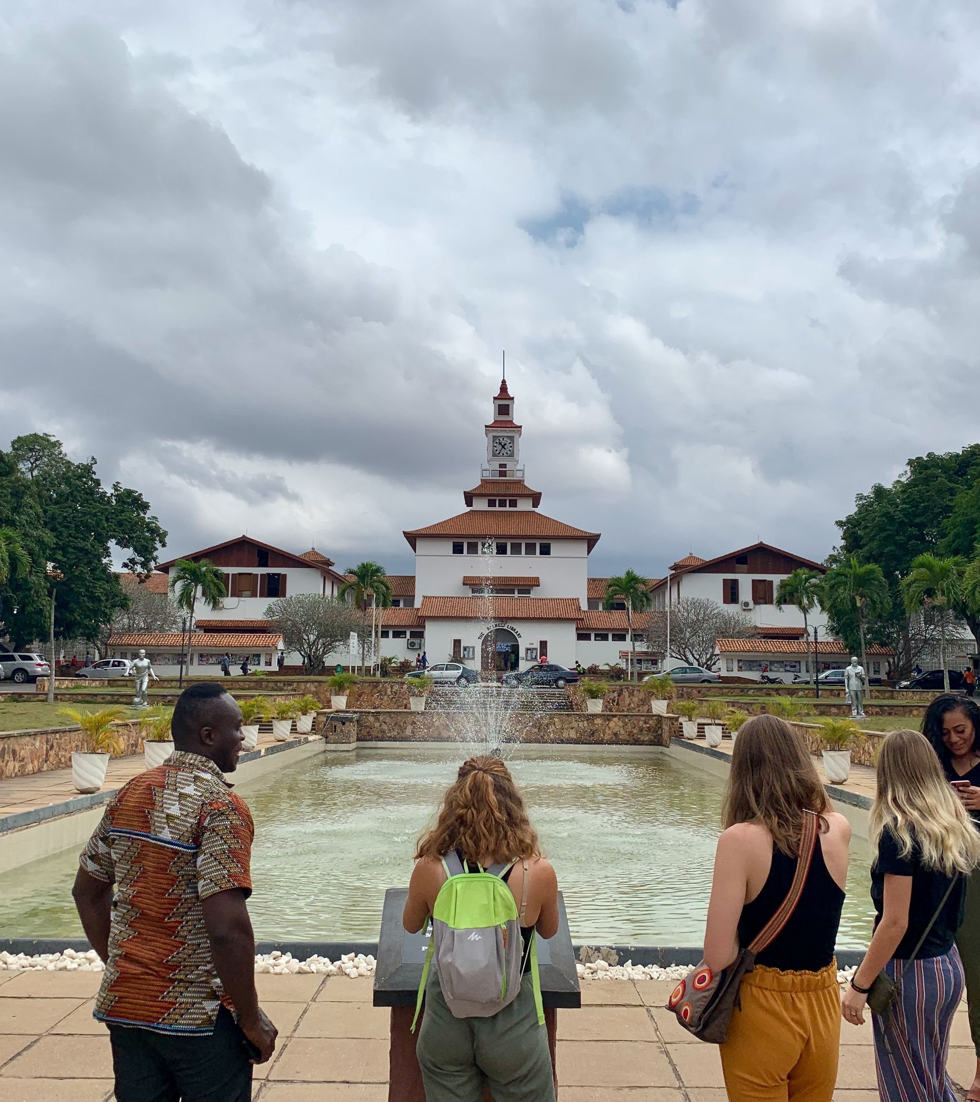





GlobalWorks Sectors
Art + Design
Business + Accounting
Data Science
Education + Teaching English
Environment + Sustainability
Journalism + Communications
Nonprofits + NGOs
Social Science
STEM + Healthcare
UNIVERSITY OF OREGON #

Slide 39
GEO Office
Location:​
Email:​
Phone:​
Website:​
Office Hours:
Oregon Hall, 3rd floor​
geoinfo@uoregon.edu​
(541) 346-3207​
geo.uoregon.edu​
9:00 a.m. – 4:00 p.m.
Monday – Friday
UNIVERSITY OF OREGON #

Slide 40

Advising
Walk-In Advising​
Monday-Friday 1:30 p.m.-3:30 p.m.​
Oregon Hall, 3rd floor​
Phone Advising​
Monday-Friday 9:00 a.m.-3:00 p.m.​
Call (541) 346-3206 for same-day call back​

Slide 42
NACE Career Competencies
Career & Self-Development
Leadership
Communication
Professionalism
VERSION 2
Critical Thinking
Teamwork
Equity & Inclusion
Technology
UNIVERSITY OF OREGON #

Slide 43
General Slide Design Principles and Presentation Tips
Follow the sample pages in the template to ensure a consistent look.
Use the Source Sans Pro Typeface as shown.
Use the University of Oregon’s brand colors found in the template’s color palette.
Keep the text on your slide to a minimum. Use abbreviated points of information and use speaker notes to further elaborate.
Use images to reinforce what you say. It’s not the amount of slides you have… it’s the time spent on them. One slide with three pieces of information may take you three minutes to speak to. In the meantime, your audience is reading ahead or looking back, missing what you are saying. That same information, separated into three slides, will still take you three minutes to speak to, but your audience’s attention is firmly focused on the topic you’re speaking to.
UNIVERSITY OF OREGON #

Slide 44
UO Brand Colors
Color Selection
Seven of our brand colors are built into the template’s color theme; these appear on every color pull-down menu. Avoid the tints and shades that PowerPoint automatically generates beneath the Theme Colors on menus. These colors are not part of our brand palette.
UNIVERSITY OF OREGON #

Slide 45
Applying URLs
URL Element
In-Text URL Styles
Using a consistent style for URLs helps our audiences immediately recognize a call to action and find more information online.
When there is a URL in the text, simply insert a link and it will be styled in
UO Green with an underline applied. When links are over a UO Green Background, change the link color to UO Yellow
or white.
Link text should be descriptive and provide a clear indication of where the link goes.
website.uoregon.edu
website.uoregon.edu
website.uoregon.edu
UNIVERSITY OF OREGON #

