Slide 1
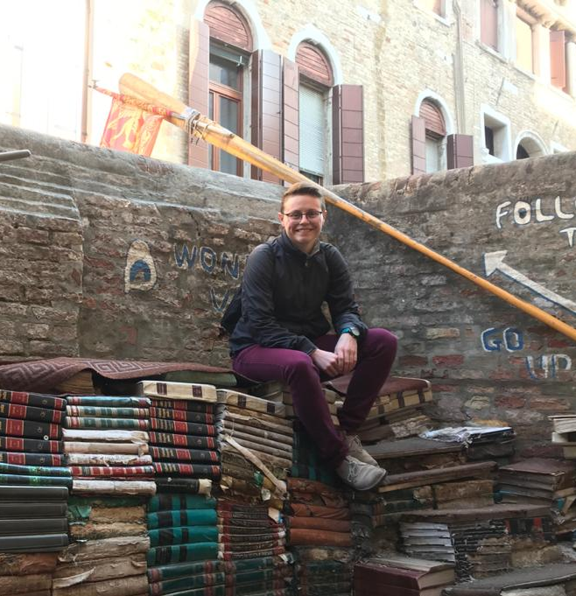
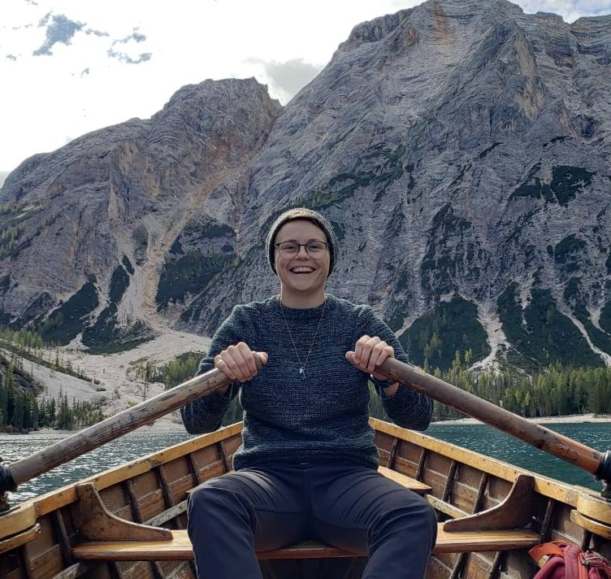

Slide 2
Stats
1268
There are
students studying abroad with GEO this summer.
318
Of those,
self-identify as LGBTQIA+.
That’s over 25%!

Slide 3
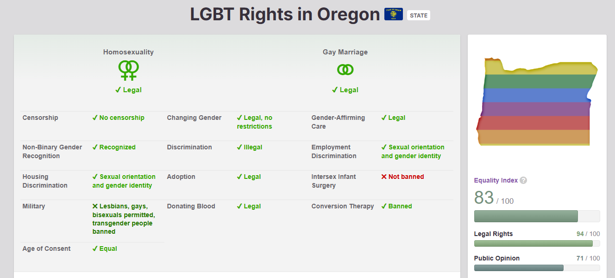
Equaldex

Slide 4
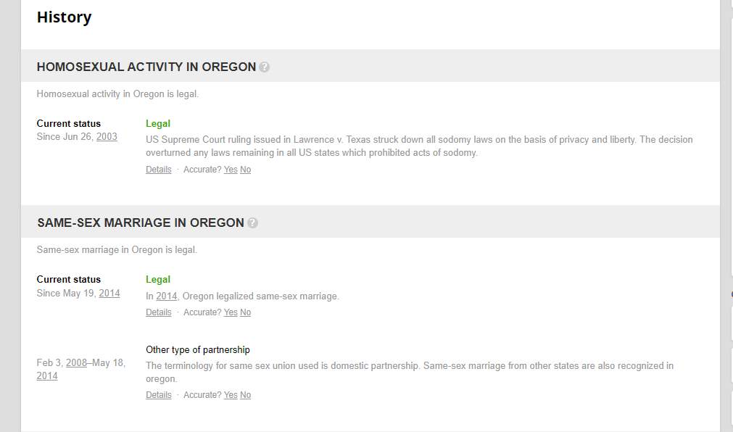
Equaldex

Slide 5
Advice!
“My advice is to find/meet people of similar identities abroad. You can do a bunch of research beforehand, but honestly most of what you will find is probably a little outdated and a lot of the questions you want to be answered you probably can't find. Join your universities Queer club or equivalent, meet people on dating apps, at gay bars or any other place queer folks gather.”
“I wasn't out whilst in England but nevertheless, going abroad for the term was perfect in helping me figure out my gender and sexuality, since nobody knew me and therefore had no expectations, nor did it matter too much what they thought since it was only a few months. I didn't see much of an LGBTQ scene, esp. compared to here in Eugene (and the one gay nightclub in Norwich is frequented by a lot of straight people) but I also didn't see/experience any homophobia or transphobia.”
“You will grow from this experience but it is not your only chance to grow in life. You will become stronger as an adult in ways you can't even imagine yet and it's awesome. Make a plan of what you want to get out of this experience! Be intentional. Want to find job there after graduation? Start early! No matter the country I believe there is always a way for you to still be YOU while respecting the local culture.”

Slide 6
Advice!
“If you have concerns about being discriminated against in a different country definitely share them with the advisor, they can easily connect you to resources there in the city and don't feel bad confiding in them. They are there to look after you and make sure you feel safe.”
“If your abroad country has a community space dedicated to celebrating LGBTQ+ voices and people, I would absolutely recommend going there. I think that because you are in another country, you may feel more free to express yourself (depending on the country, of course). Personally, I felt more open to expressing my identity while abroad because being in a place where I don't permanently live gave me more freedom from societal and culture pressures that affected my personal life while at home. Talking to other queer people also helped me make priceless friendships and gave me more context of LGBTQ+ culture outside of the US. There's also the added bonus of helping improve your language skills!

Slide 7
Advice!
“I studied abroad in Copenhagen Denmark and it was one of the best experiences of my life! It encouraged me to move out of the country after I graduated and I am now studying in the UK! I’m applying for jobs in London and Amsterdam and can honestly say if it wasn’t for my trip abroad my Junior year at UO, I would have never discovered a new feeling of home overseas!”
“Research how queer friendly your area is (Reddit was helpful for me) and choose how willing you are to be outspoken about your identity or what level you’re willing to go to in order to pass. In some places, it won’t come up aside from waitstaff asking “what can I get for you, sir/ma’am?” But in others, how you’re viewed may change your entire experience. It will depend on the country and possibly the activity you’re doing. Also decide what type of comfort is more important: would you rather pass, or be able to move comfortably on a strenuous excursion? For example, I can’t deal with high heat, so a binder was out of the question, but one of my friends would rather appear flat chested than not, even if it meant being extra sweaty. If you’re trans, it is NOT worth hurting yourself to pass, but at the end of the day it’s your decision. Everyone deals with different levels of comfort and discomfort with being out or not passing.”

Slide 8
Advice!
“1) Research the culture and attitudes of the place(s) you're visiting. Understanding local norms might help you feel more comfortable and safe in a new environment.
2) Make a list of places you want to visit/things you want to do. You'll get the most out of this experience with a plan.
3) Make friends!! Talk to the people you're travelling with! Go places together! Everything is more fun when you don't have to do it alone.”
“I went into my study abroad program with an open mind ready to be friends with whoever would talk to me, because I was so afraid to be traveling that far by myself. I made a lot of friends in my dorm and my class, and I went to events hosted by the program, too! Most of the people I met were all nice and friendly, but the ones I really connected with were the other queer people I met. Most nights, I opted for a night in to hangout with them instead of going out to bars with my classmates. Even though some might say I missed out on the night life, I never regretted my decision. Finding other queer friends through this experience made it something special on another level and gave me so many lovely unforgettable memories!!”

Slide 9
Encouragement!
“You are valid in your identity and going to a different place shouldn't change that. Be safe, but also at least in my experience other cultures can be more open to difference than you think.”
“You are who you are and there's no reason to ever be ashamed of yourself for your sexuality or gender. You know who you are and you're doing amazing. :)”
“Be open, have fun, and enjoy it!!! In the moment, it might feel like things aren't going as well as you'd hoped. It's easy to get caught up in/on things and start to shut down, but try and just take a moment, and enjoy the experience. Looking back, you're going to wish you could go back and realize how much fun you had. Try and remember that when you're in the moment, and don't get caught up in little things that (in the long run) really don't matter that much. Make connections, have a positive and open mindset, and have fun. It really is a life-changing experience, and you will meet so many people.”

Slide 10
Encouragement!
“Studying abroad was a lot of fun and a great time to experiment with identity! I highly recommend for any other closeted or questioning students.”
“Be authentically true to yourself when studying abroad, and don't be afraid to reach out to LGBTQ+ circles if you can. It is important to keep in mind that some places you go to may not be as welcoming as your home country, but no matter what you will find other LGBTQ+ who are eager to make friends. Queer people have always existed, no matter where they live; if you look around, I'm sure you'll find someone you can connect with!”
“Be proud of who you are even in environments that do not celebrate our community. You are amazing, and you deserve the world!”

Slide 11
Encouragement!
“The truest thing someone said to me before I went on my study abroad trip was that in the moment, not every day will be great, but when you get home, what you'll remember most are the amazing experiences and positive memories you made. Take advantage of the opportunities you are given and just enjoy the experience!”
“Study abroad is a lot of fun! Being misgendered once or twice was nothing compared to the other experiences I had.”
“You should do it even if it terrifies you! I originally signed up for the program with a friend who ended up not going. I had a lot of anxiety about the trip because it was so far outside of my comfort zone to travel alone, but I ended up having such an amazing meaningful time. I'm so glad I went because I learned and grew so much in just three weeks, and overcame a lot of my fears, too!”

Slide 12
Encouragement!
“I was so nervous and had an immense fear of the unknown and flying but if I had not taken that leap to study abroad I would be living a completely different life right now! Go wherever makes you HAPPY— it’s so simple but so easy to forget. Being open to new possibilities and new people means abandoning norms that are safe and comfortable. Forcing yourself into new environments allows you to learn and grow in ways categorically different from standard western and US ideological practices.”
“You can 100% find your community. LGBTQ+ community is diverse, I think making friends with locals instead of just fellow study abroad folks is actually easier when you are queer. Because seeking out LGBTQ community you are given more opportunities to connect with local folks on common ground.”

